Slide 1
Relation-based Counterfactual Explanations for Bayesian Network Classifiers
Emanuele Albini ^{1,2} (me), Antonio Rago ², Pietro Baroni ¹ and Francesca Toni ²
¹ University of Brescia, IT ² Imperial College London, UK
Published at the
29th International Joint Conference on Artificial Intelligence, IJCAI 2020

Slide 2
Types of explanations
Attribution methods
They attribute a numeric score on the importance of each of the features.
Causal explanations
Why did you predict $y$ given $x$?
i.e. what caused $y$?
Relation-based
They describe how variables relate to each other.
Counterfactual explanations
How $x$ should change for $y$ to change?
i.e. they analyse hypothetical scenarios
Example-based
They provide examples of classifications
Several other recent proposals of counterfactual explanations methods, for example:
FACE (Feasible and Actionable Counterfactual Explanations) Poyiadzi et al, AIES20
DICE (Explaining Machine Learning Classifiers through Diverse Counterfactual Explanations) Mothilal et al, FAT*20
CLEAR (Measurable Counterfactual Local Explanations for Any Classifier) White and Garcez. ECAI2020

Slide 3
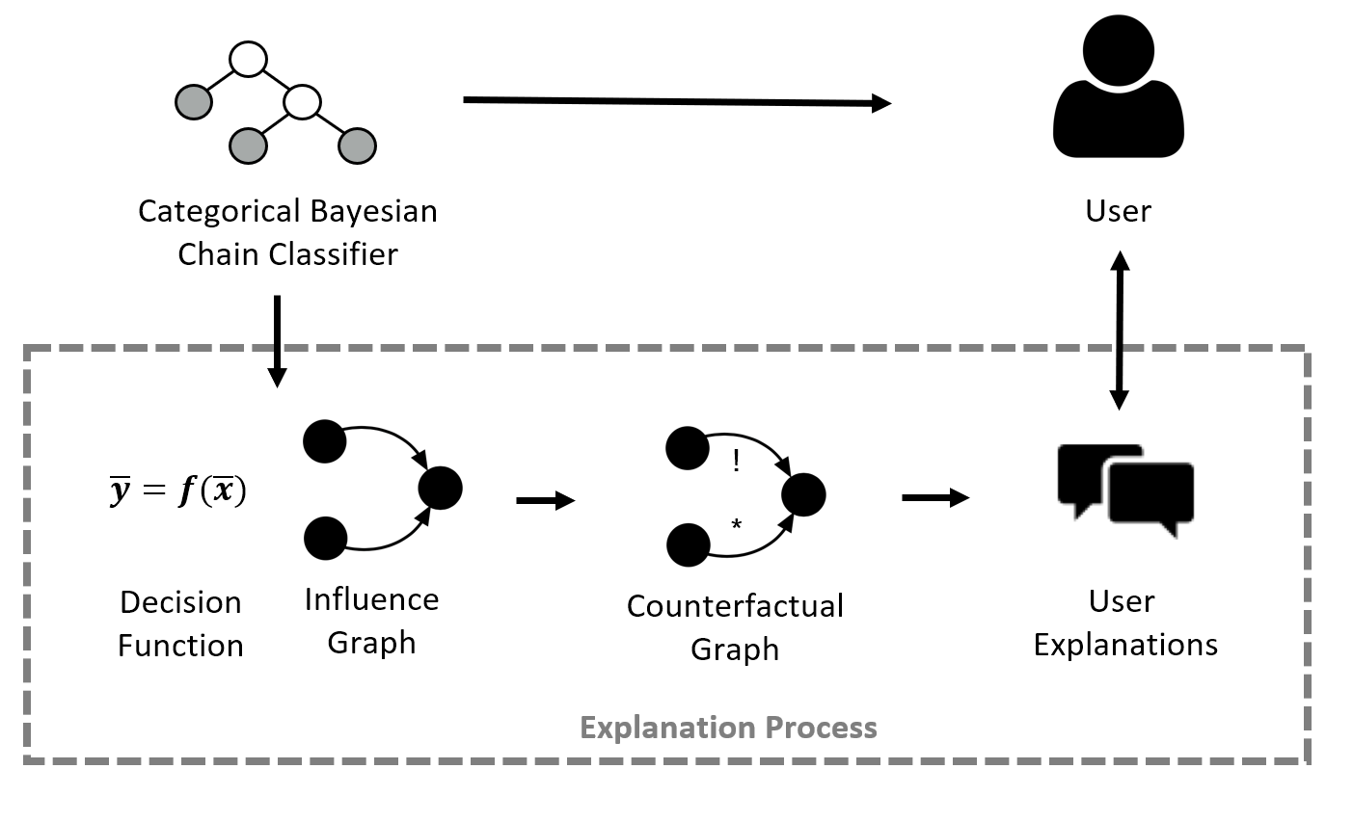
High-level diagram

Slide 4
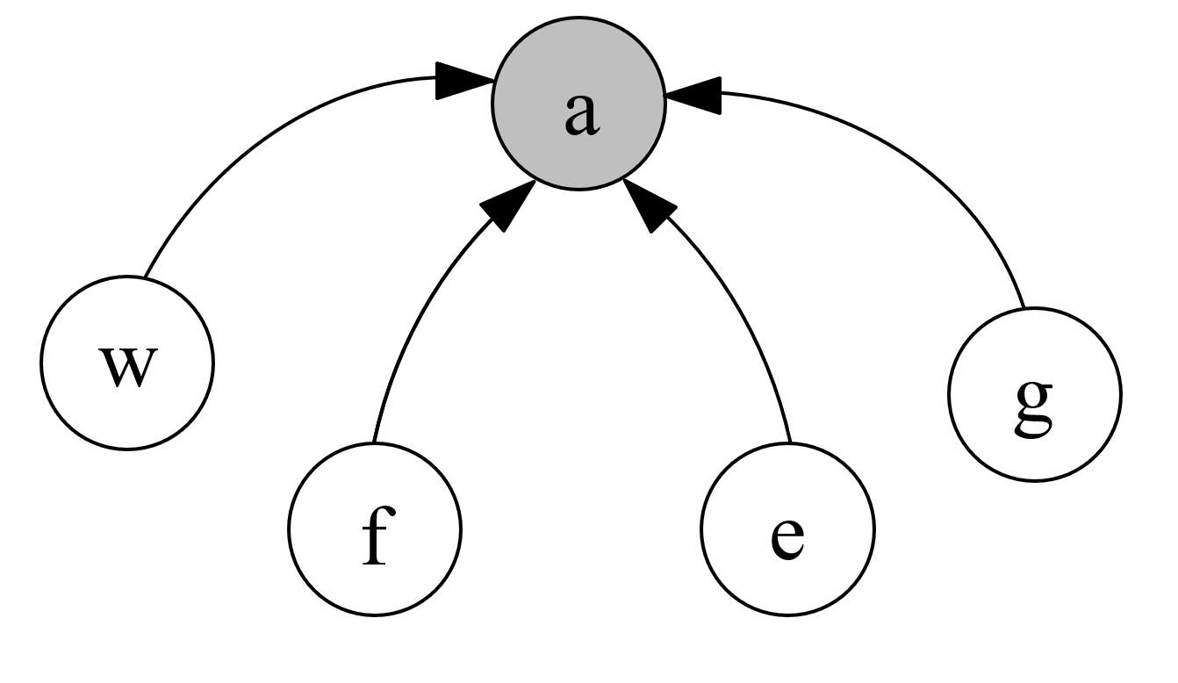
From Naïve Bayesian Classifiers to Influences
We understand Bayesian classifiers as a set of observation and classification variables, with influences between them.
$$\underline{a}dmission$$
a
classification
$$\underline{w}ork$$
$$experience$$
$$met$$
$$\underline{G}PA$$
$$\underline{f}irst time$$
$$applicant$$
$passed$
$$\underline{e}xam$$
conditional dependencies
influences
observations

Slide 5
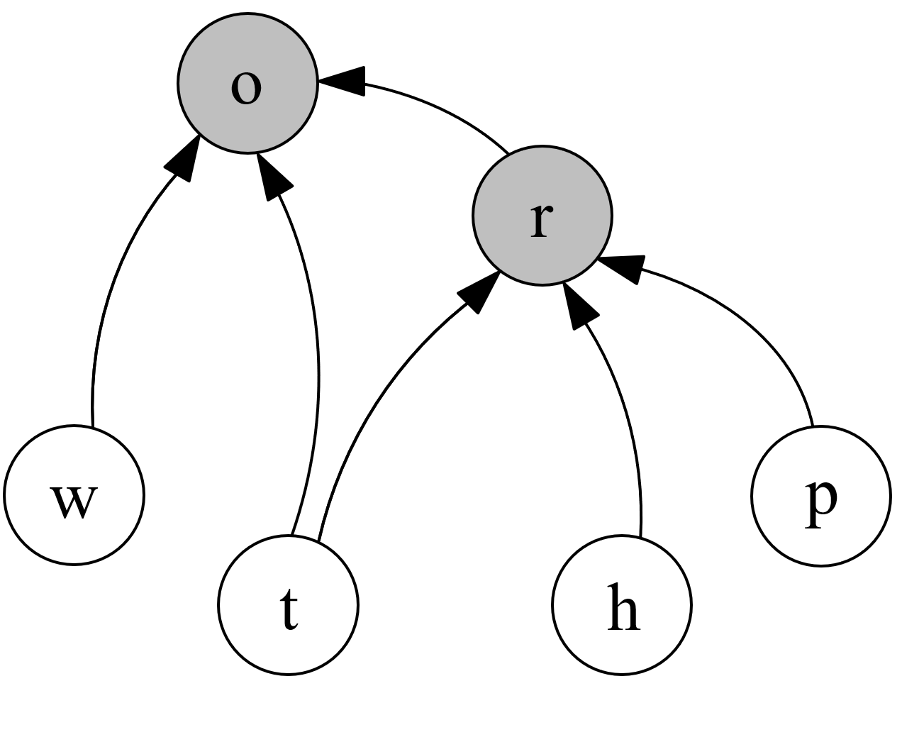
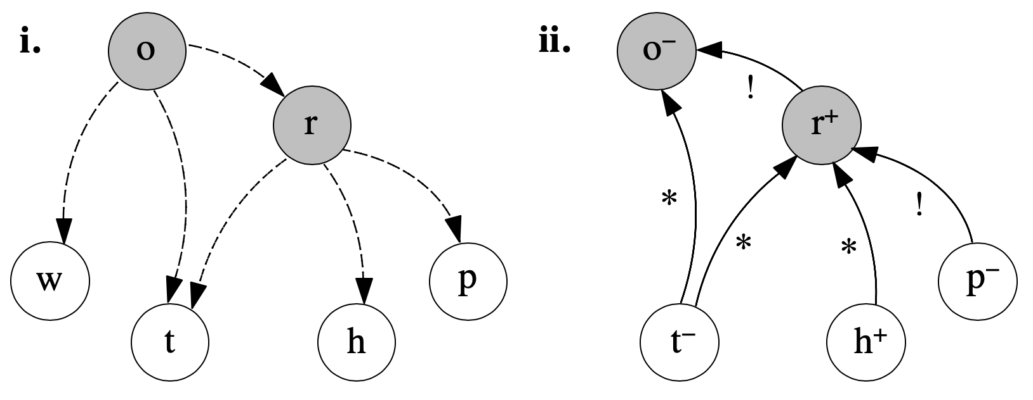
From Bayesian Chain Classifiers to Influences
classifications
Naïve BC
$$play$$
$$\underline{o}utside$$
$$\underline{r}ain$$
Naïve BC
$$\underline{w}ind$$
$$\underline{p}ressure$$
$$\underline{t}emperature$$
$$\underline{h}umidity$$
observations
conditional dependencies
influences
influences can be drawn in the opposite direction to the conditional dependencies because they are chain classifiers.

Slide 6
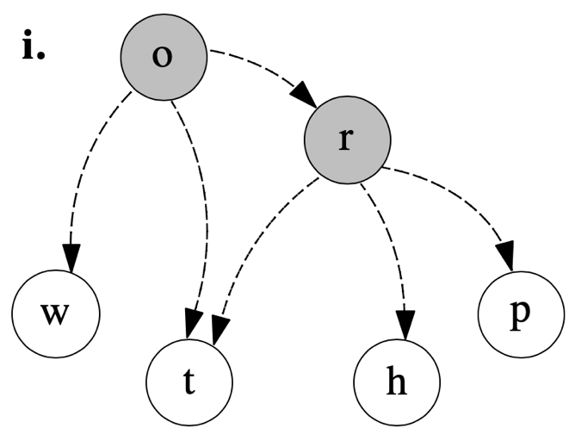
From Bayesian Classifiers to Decision Functions
classifications
We considered Bayesian Classifiers (BCs) as decision functions that make predictions on classification variables based on observations.
$$play$$
$$\underline{o}utside$$
$$\underline{r}ain$$
MAP
Maximum A Posteriori
$$\underline{w}ind$$
$$\underline{p}ressure$$
$$\underline{t}emperature$$
$$\underline{h}umidity$$
observations
conditional dependencies
* In this example, the variables are all binary but the methodology can be applied to any discrete classifier
6

Slide 7
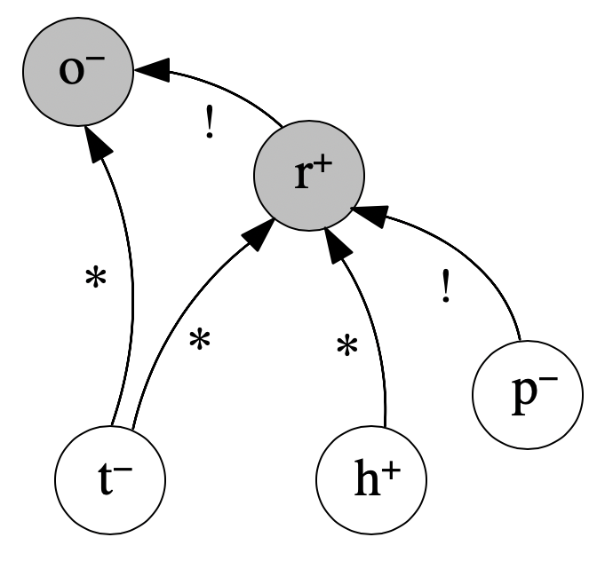
Support Relations: Critical and Potential Influences
A change of $p$ from $−$ to $+$
changes $r$ from $+$ to $−$
A change of $h$ from $+$ to $−$ brings closer a change of $r$ from $+$ to $−$
w–
Influences may then be categorised as specified relations in the CFX by these properties
A variable 𝛼 critically (!) influences 𝛽 iff any change to variable 𝛼 directly brings a change in variable 𝛽.
A variable 𝛼 potentially (*) influences 𝛽 iff a change to variable 𝛼 does not directly bring about a change in variable 𝛽 but it brings you closer to it.
Or none of them

Slide 8
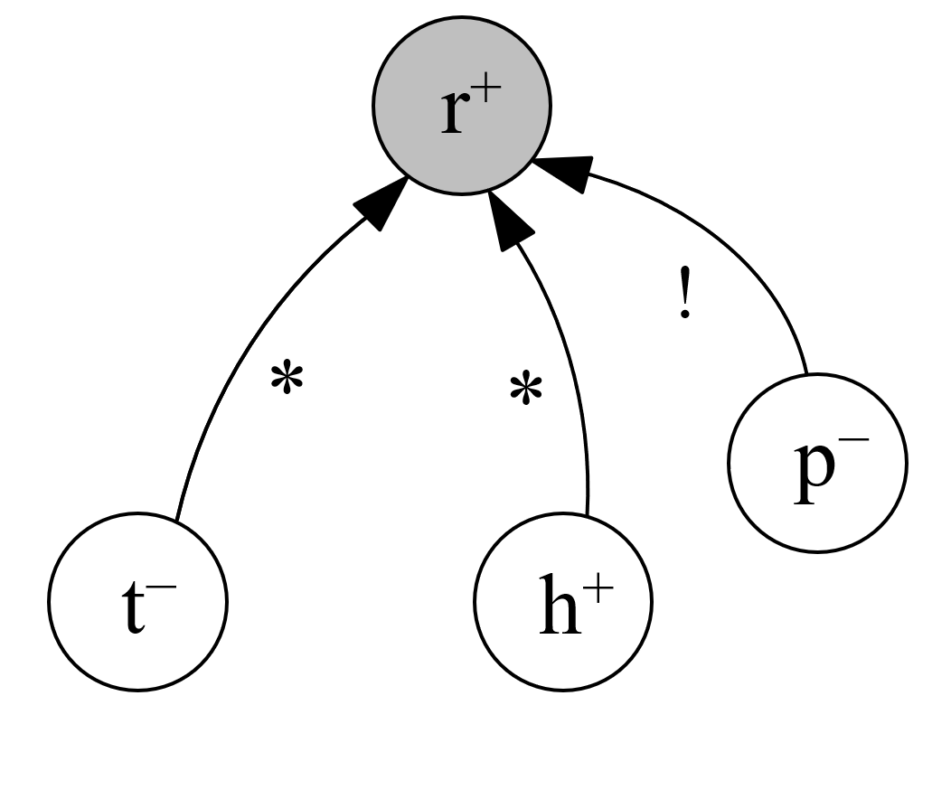
Properties of our relation-based counterfactual explanations
Uniqueness
$$∃!$$
Given a sample the CFX is unique
→ A user do not have to go through many explanations
Explanation for $r$
Explanation for $o$
Compositionality
An explanation can be generated as the composition of the explanations of the variable with a relation of influence with the explanandum.

Slide 9
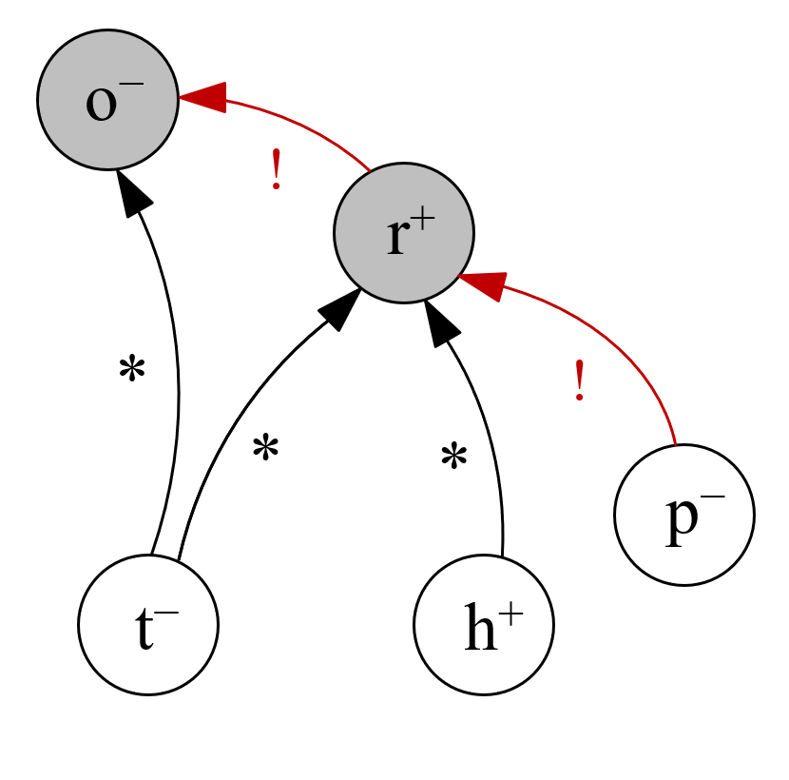
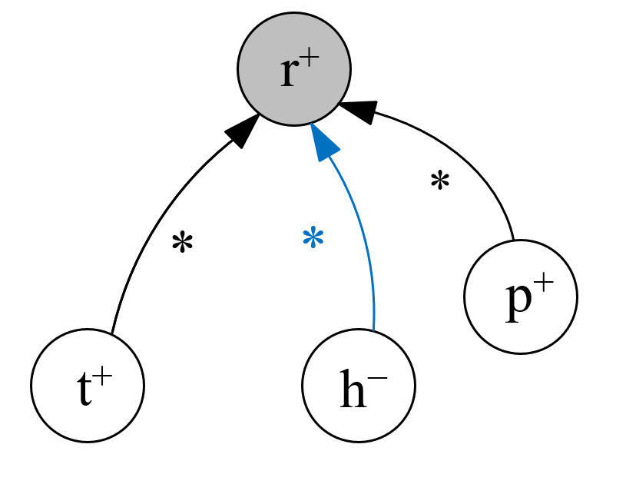
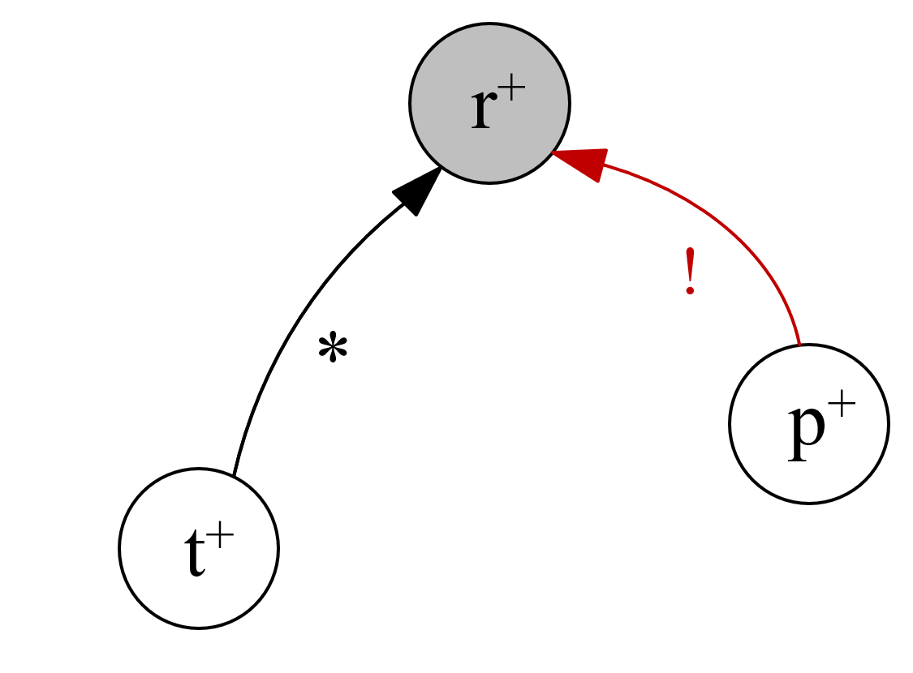
Properties of our relation-based counterfactual explanations
A change of a variable with a relation of critical influence, leads to “cascade” effect on the path of critical influences leading to a change of all the variables on the path.
Critical Influences
Chaining
→ This is useful for creating a counterfactual samples
If I change a variable with a relation of potential influence:
Potential Influences Convergence
Critical influences cannot decrease in number
$$h^{−}→h^{+}$$
Potential influences cannot increase in number
In other words potential influences bring us closer to a change in the classification (i.e. closer to a critical influence)

Slide 10
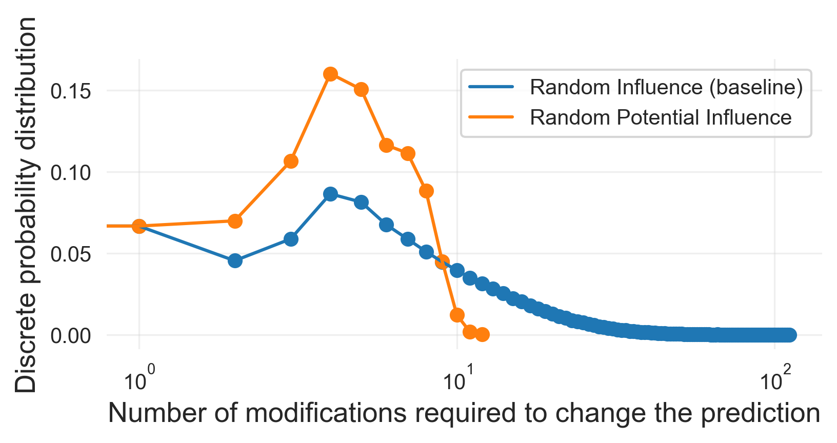
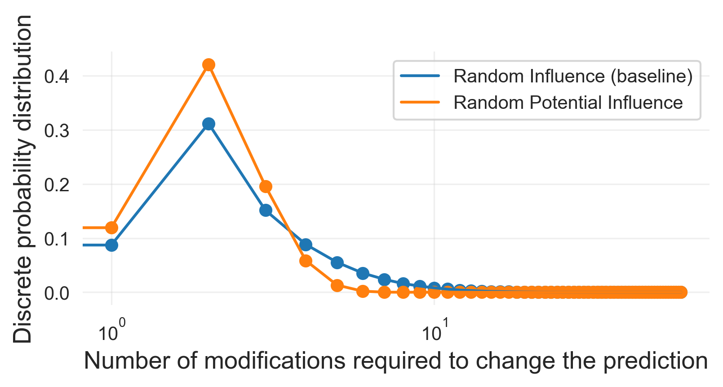
Experiments – Random walks towards a change in the classification
Yes
No
Randomly change an influencing variable (baseline)
classification change
change it
$∃$ critical influence?
Randomly change a potentially influencing variable
Number of steps required to change the prediction
Number of steps required to change the prediction
The worst case scenario considerably improves
Using potential influences reduces the average number of steps required to reach a classification change

Slide 11
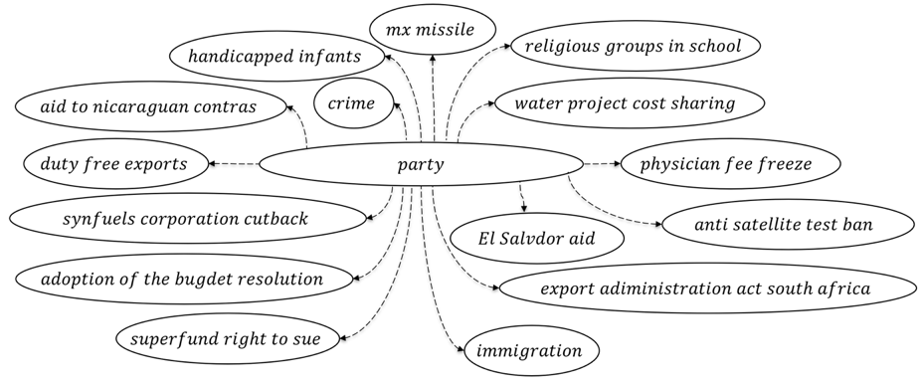
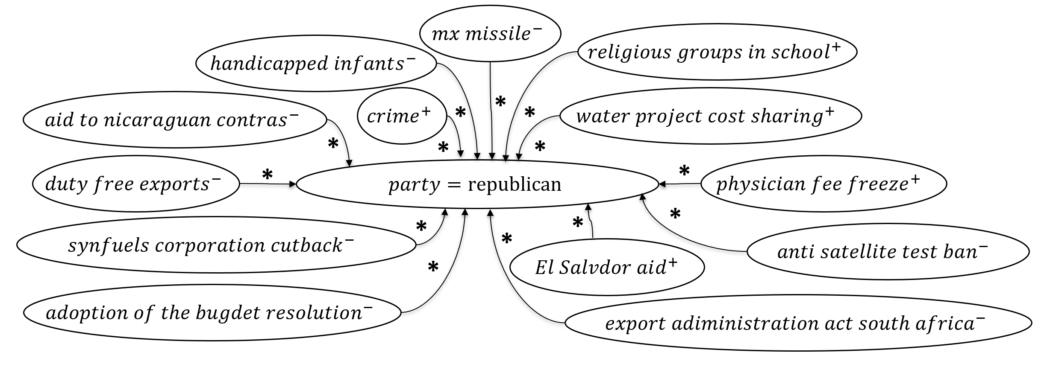
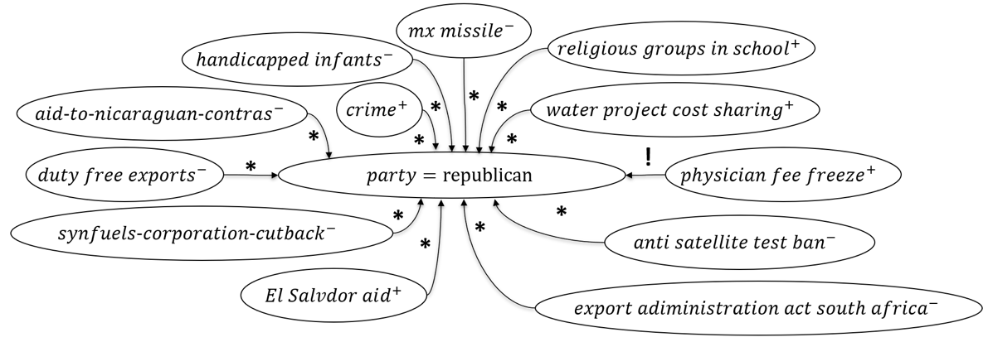
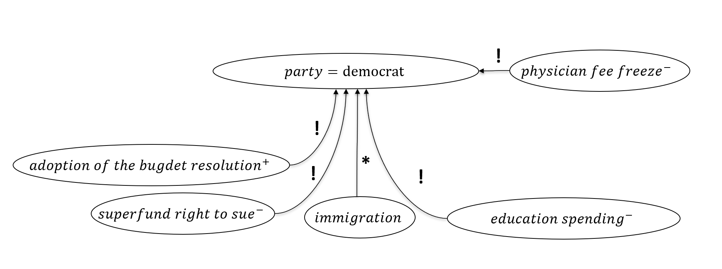
Usage Examples
Generation of counterfactuals. In a naïve BC which predicts the class of a congressman given votes.
v

Slide 12
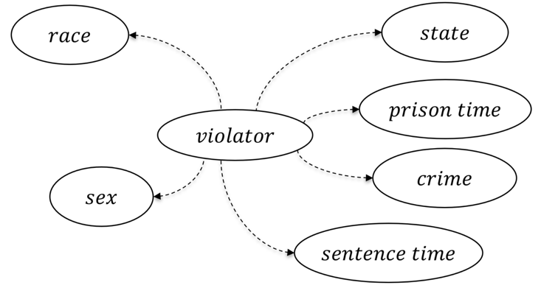
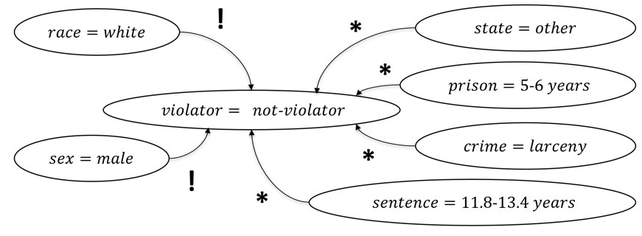
Usage Examples
Identification of discriminatory bias. In a naïve BC that predicts the parole violation
Discrimination

Slide 13
Examples: a “deep” classifier
This classifier predicts the Disease of a baby that present birth asphyxia using some inputs using some “intermediate” variables in the Bayesian network.

Slide 14
Examples: a “deep” classifier

Slide 15
Examples: a “deep” classifier

Slide 16
Examples: a “deep” classifier

Slide 17
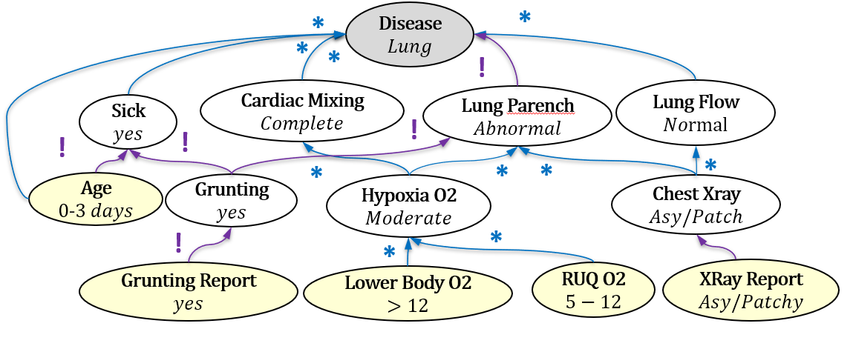
Examples: generate a conversation from the counterfactual relation graph
The relation-based representation of counterfactual explanations allow the user to potentially interact with it through a template-based conversation.
The Disease is predicted to be Lung with 87.9% confidence
Which variables could definitely cause a change in Disease being Lung?
Which variables could potentially cause a change in Disease being Lung?
Which variables do not play any role in changing Disease to another value?

Slide 18
Examples: generate a conversation from the counterfactual relation graph
The Disease is predicted to be Lung with 87.9% confidence
The relation-based representation of counterfactual explanations allow the user to potentially interact with it through a template-based conversation
Which variables could surely cause a change in Disease being Lung?
Lung Parench that is currently predicted to be Abnormal
Which variables could definitely cause a change in Lung Parench being Abnormal?
Which variables could potentially cause a change in Lung Parench being Abnormal?
Which variables do not play any role in changing Lung Parench to another value?
What about other variable that could be playing a role in the change of Disease?

Slide 19
Examples: generate a conversation from the counterfactual relation graph
The relation-based representation of counterfactual explanations allow the user to potentially interact with it through a template-based conversation
The Disease is predicted to be Lung with 87.9% confidence
Which variables could surely cause a change in Disease being Lung?
Lung Parench that is currently predicted to be Abnormal
Which variables are potentially causing a change in Lung Parench being Abnormal?
Hypoxia O2 and Chest Xray
What about Chest Xray?
What about Hypoxia O2?

Slide 20
Examples: generate a conversation from the counterfactual relation graph
Lung Parench that is currently predicted to be Abnormal
Which variables are potentially causing a change in Lung Parench being Abnormal?
The relation-based representation of counterfactual explanations allow the user to potentially interact with it through a template-based conversation
Hypoxia O2 and Chest Xray
What about Chest Xray?
Chest Xray is currently predicted to be Asy/Patch
Which variables could definitely cause a change in Chest Xray being Asy/Patch?
Which variables could potentially cause a change in Chest Xray being Asy/Patch?
Which variables do not play any role in changing Chest Xray to another value?
What about other variable that could be playing a role in changing Chest Xray?

Slide 21
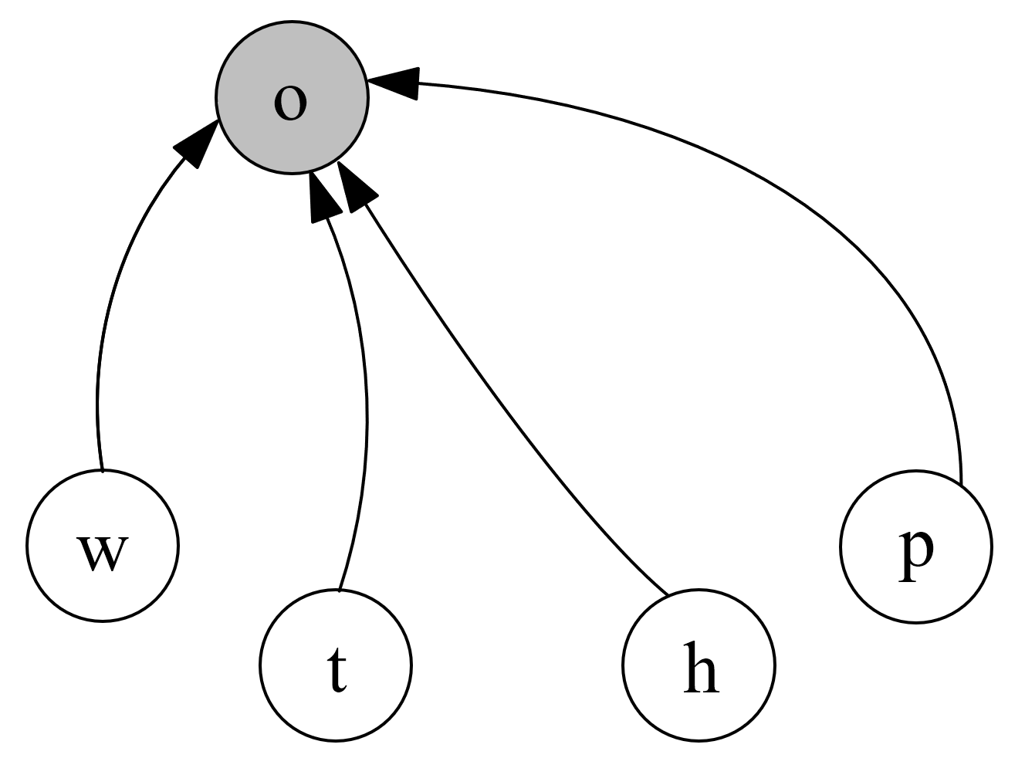
Comparison with example-based methods
$$play$$
$$\underline{o}utside$$
$$\underline{r}ain$$
CFX
w–
$$\underline{w}ind$$
$$\underline{p}ressure$$
$$\underline{t}emperature$$
$$\underline{h}umidity$$
$$\{\left(w^{−},t^{−},h^{+},p^{+}\right), …\}$$
Model-agnostic example-based counterfactual explanations
Shallow graph
Do not provide the counterfactual relationships between variables

Slide 22
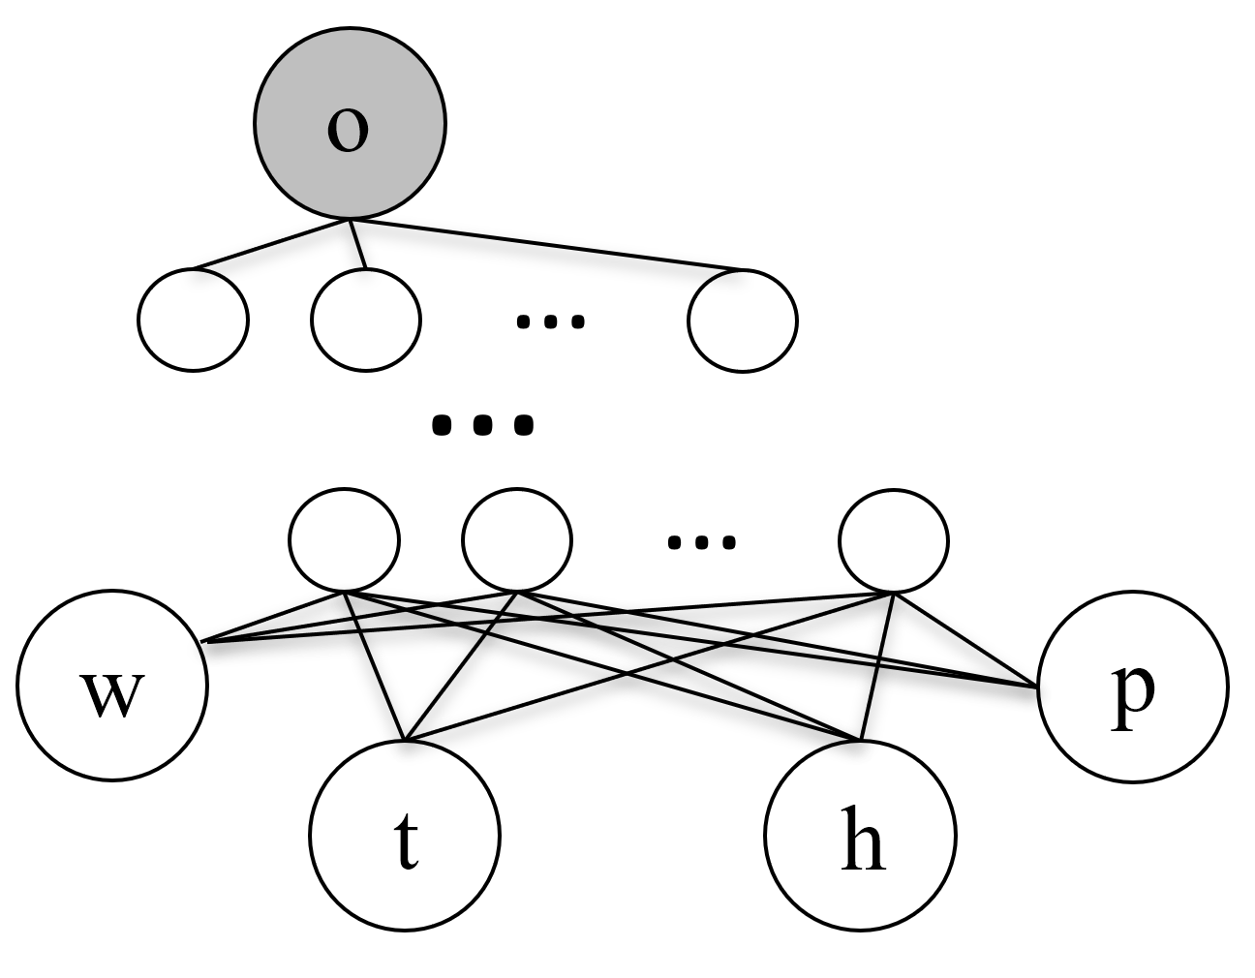
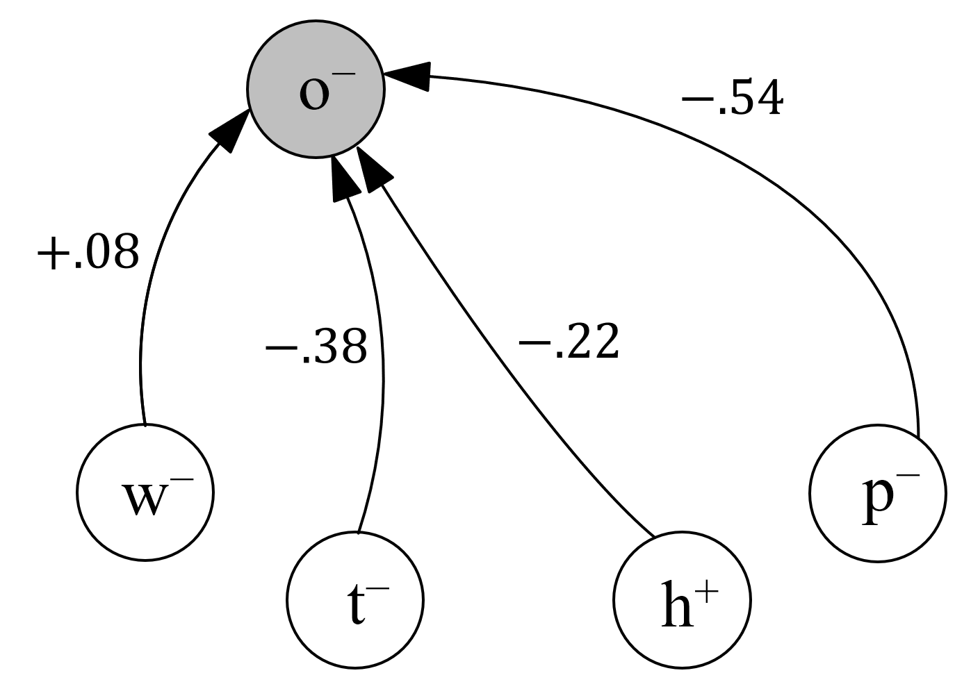
Comparison with attribution-based methods
$$play$$
$$\underline{o}utside$$
$$\underline{r}ain$$
CFX
w–
$$\underline{w}ind$$
$$\underline{p}ressure$$
$$\underline{t}emperature$$
$$\underline{h}umidity$$
Feature attribution methods
The assumption in model-agnostic attribution methods is that each output is influenced by every input
LIME "Why Should I Trust You?": Explaining the Predictions of Any Classifier, Marco Tulio Ribeiro, Sameer Singh, Carlos Guestrin (2016).

Slide 23
Comparison with prime implicants methods
$$play$$
$$\underline{o}utside$$
$$\underline{r}ain$$
CFX
w–
$$\underline{w}ind$$
$$\underline{p}ressure$$
$$\underline{t}emperature$$
$$\underline{h}umidity$$
$$\{\left(h^{+},p^{−}\right),\left(t^{−},p^{−}\right)\}$$
Prime Implicants
(subset minimal set of the inputs such that $o$ does not change)
The number of prime implicants can be very high, it is useful for debugging but can be cognitively demanding for final users
*PIX & MCX A symbolic approach to explaining Bayesian network classifiers, Shih, A., Choi, A., & Darwiche, A. (2018). IJCAI, 2018, 5103–5111.

Slide 24
Experiments – Explanation length and size
PIX are not unique
For 435 samples 135,478 prime implicants are generate (311 prime implicants per sample on average)
CFX are unique per sample
PIX = Prime Implicant eXplanation *
CFX = Counter-factual eXplanation (ours)
*PIX & MCX A symbolic approach to explaining Bayesian network classifiers, Shih, A., Choi, A., & Darwiche, A. (2018). IJCAI International Joint Conference on Artificial Intelligence, 2018, 5103–5111.

Slide 25
Discussion / Future Work
Metrics to evaluate counterfactuals proposed in the literature*
More fine grained counterfactual relations
!
*
If there is critical influence a classification change is 1 change away
If there are only potential influences a classification change is 2 or more changes away
*DICE Explaining Machine Learning Classifiers through Diverse Counterfactual Explanations, Mothilal et al, FAT*20

Slide 26
Relation-based Counterfactual Explanations for Bayesian Network Classifiers E. Albini, A. Rago, P. Baroni and F. Toni IJCAI 2020 (Proc. of 29th International Joint Conference on Artificial Intelligence)
Thanks for your attention! :)
Questions?

