Slide 1
Modular Machine Learning
Interpretability
A Case Study of Surrogate Explainers
Kacper Sokol, University of Bristol

Slide 2
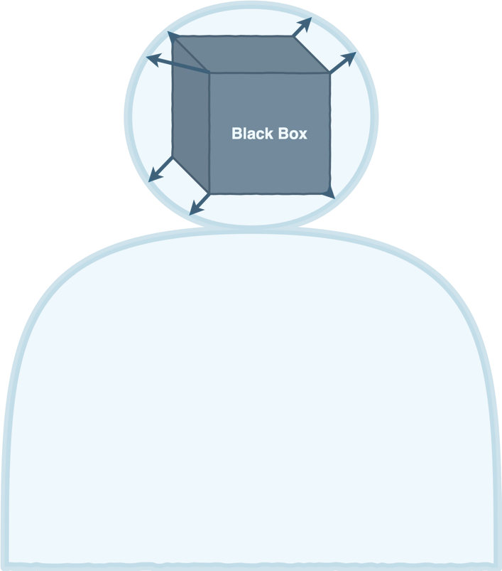
What is Explainability?
No universally accepted deﬁnition.
Simulatability
Lipton, 2018. The mythos of model interpretability.
The Chinese Room Theorem
Searle, 1980. Minds, brains, and programs.
Mental Models:
Kulesza et al., 2013. Too much, too little, or just right? Ways explanations impact end users' mental models.
Functional -- operationalisation without understanding;
Structural -- appreciation of the underlying mechanism.

Slide 3
What is Explainability?
Transparency -- insight (of arbitrary complexity) into operation of a system.
Background Knowledge -- implicit or explicit exogenous information.
Reasoning -- algorithmic or mental processing of information.
Explainability → explainee walking away with understanding.

Slide 4
Explaining AI
Exemplars:
With 23°C and clear sky, the person enjoys the weather when the humidity is low.
[humidity=low, temperature=23, rain=no] → like
[humidity=medium, temperature=23, rain=no] → dislike
[humidity=high, temperature=23, rain=no] → dislike

Slide 5
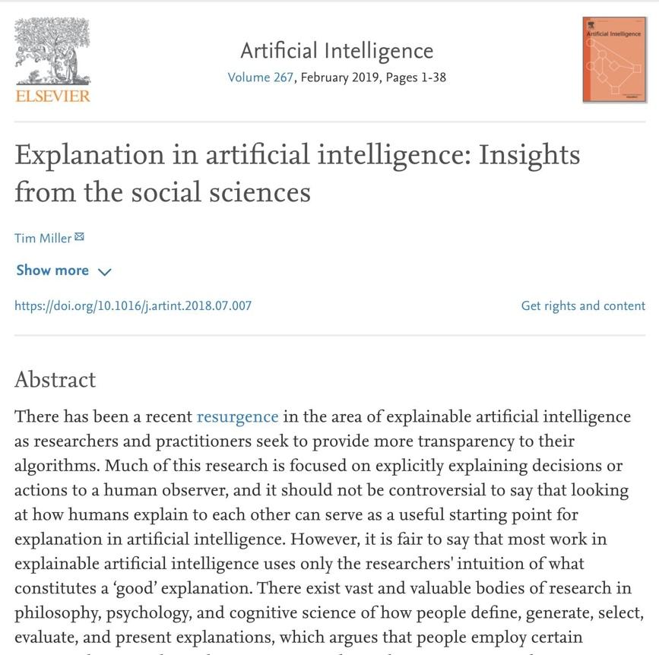
Human-centred Explainability
Human-centred explanations:
interactive dialogue (bi-directional);
contrastive statements.

Slide 6
Modular Surrogate Explainability

Slide 7
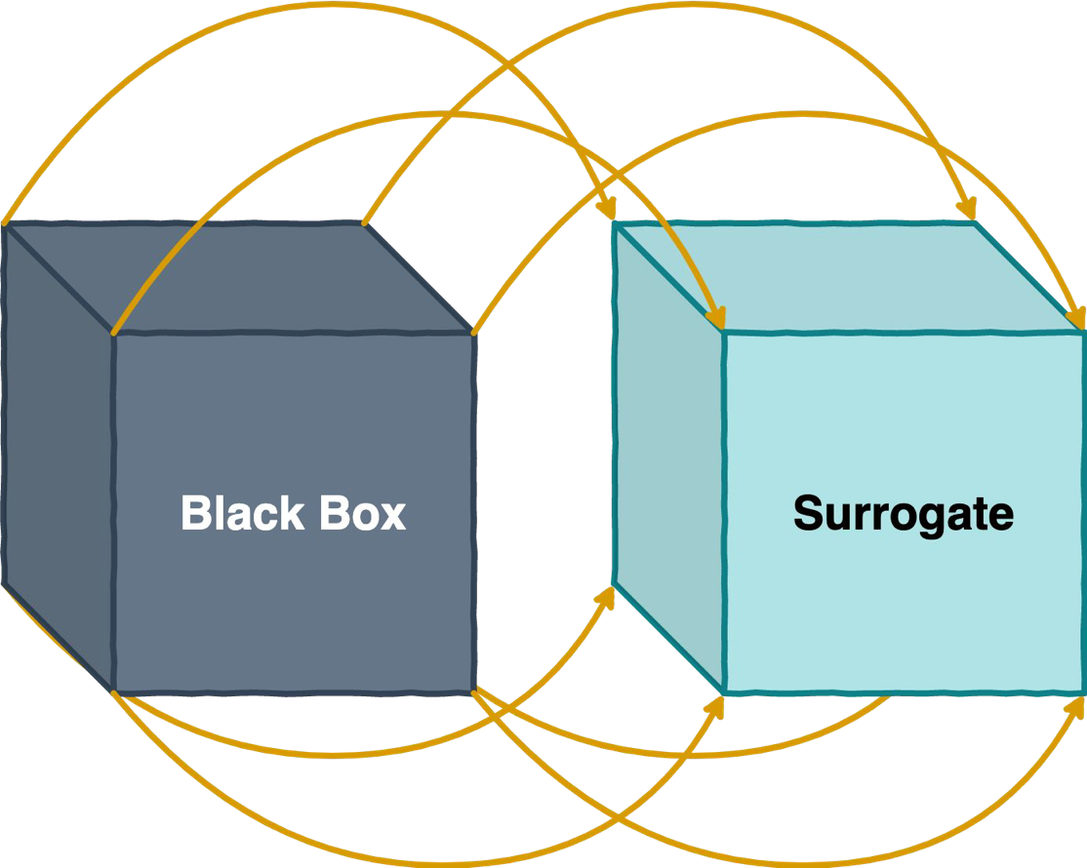
Scope: Global Surrogates

Slide 8
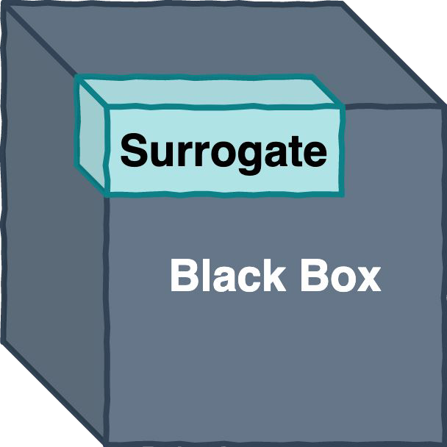
Scope: Local Surrogates

Slide 9
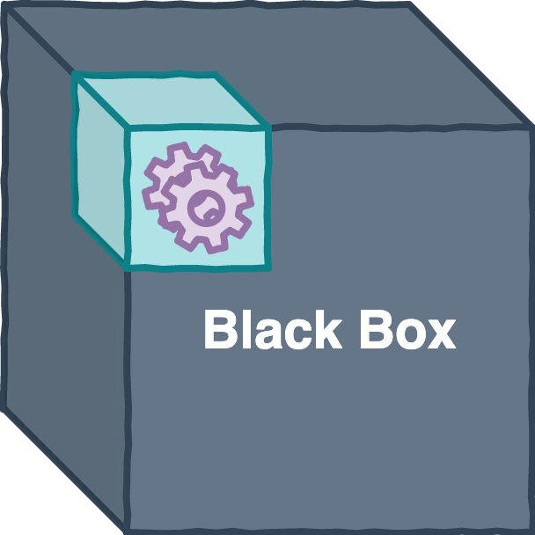
Mimicry Source: Structural Surrogate
(model)

Slide 10
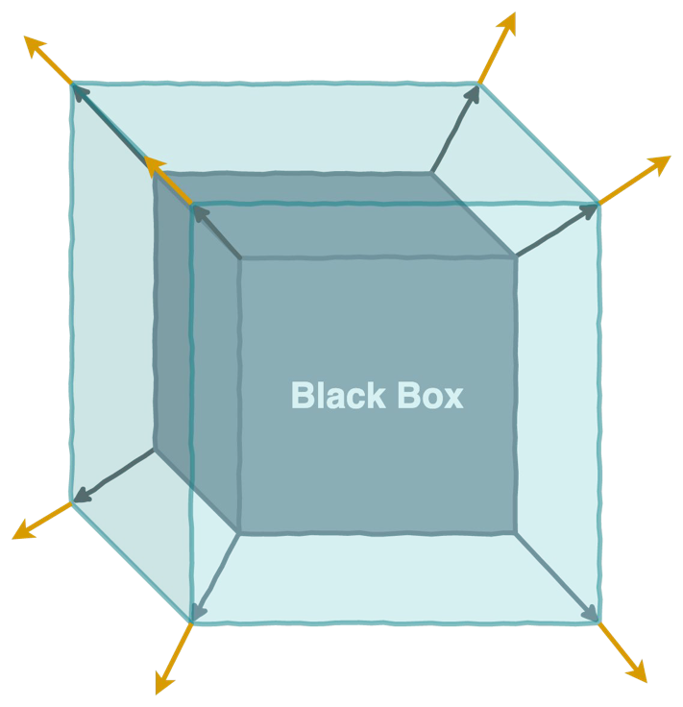
Mimicry Source: Behavioural Surrogate
(predictions)

Slide 11
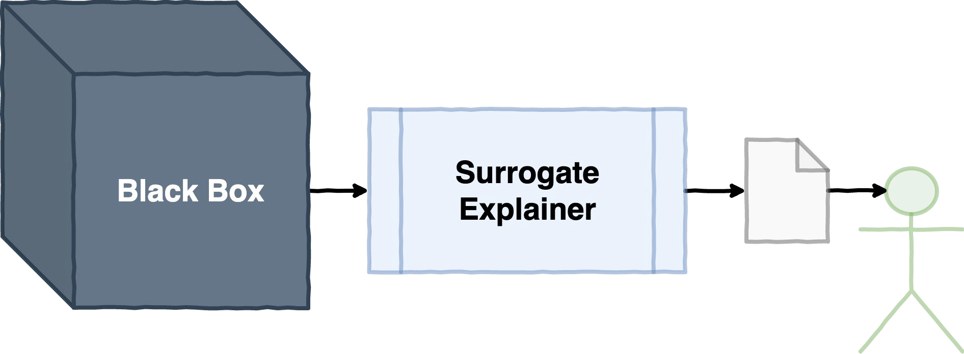
Surrogate Explainability in AI and ML

Slide 12
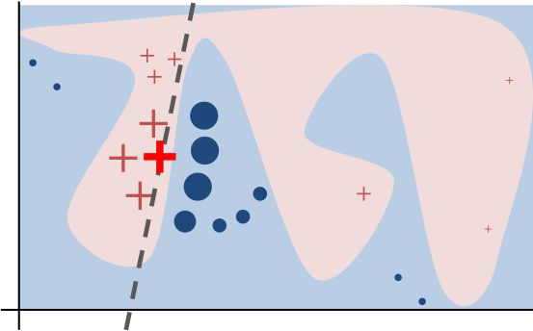
Surrogate Explainability in AI and ML
Ribeiro et al., 2016. "Why should I trust you?" Explaining the predictions of any classiﬁer.

Slide 13
The Beneﬁts of Surrogates
Model-agnostic -- work with any black box.
Post-hoc -- can be retroﬁtted into pre-existing predictors.
Data-universal -- work with image, tabular and text data because of interpretable data representations.

Slide 14
Actual Surrogate Explainers
Local Interpretable Model-agnostic Explanations (LIME)
Ribeiro et al., 2016. "Why should I trust you?" Explaining the predictions of any classiﬁer.
Anchor
Ribeiro et al., 2018. Anchors: High-Precision Model-Agnostic Explanations.
SHapley Additive exPlanations (SHAP)
Lundberg and Lee, 2017. A uniﬁed approach to interpreting model predictions.
RuleFit
Friedman and Popescu, 2008. Predictive learning via rule ensembles.

Slide 15
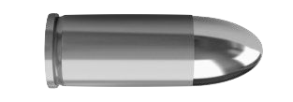
Universally Applicable Explainers
Surrogate Explainers

Slide 16
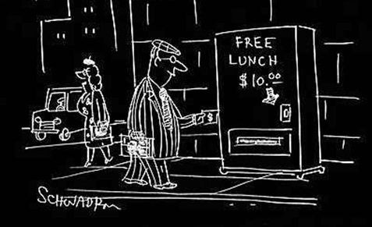
Caveat: The No Free Lunch Theorem

Slide 17
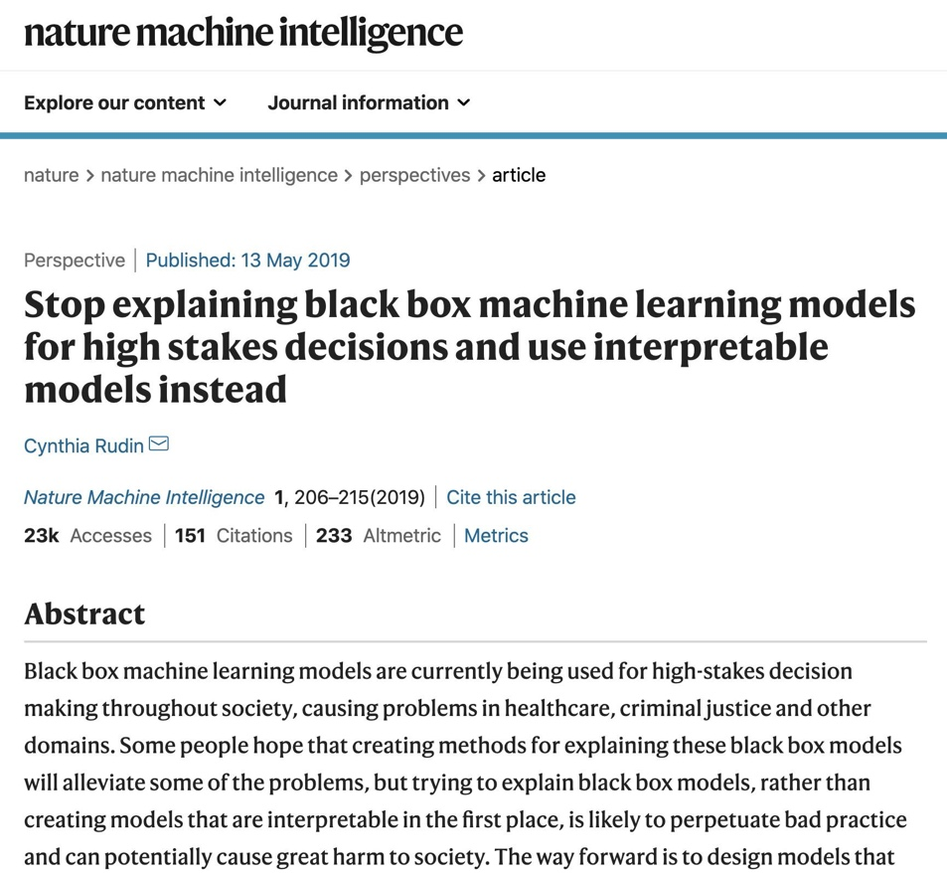
Post-hoc Explainers have Poor Fidelity

Slide 18
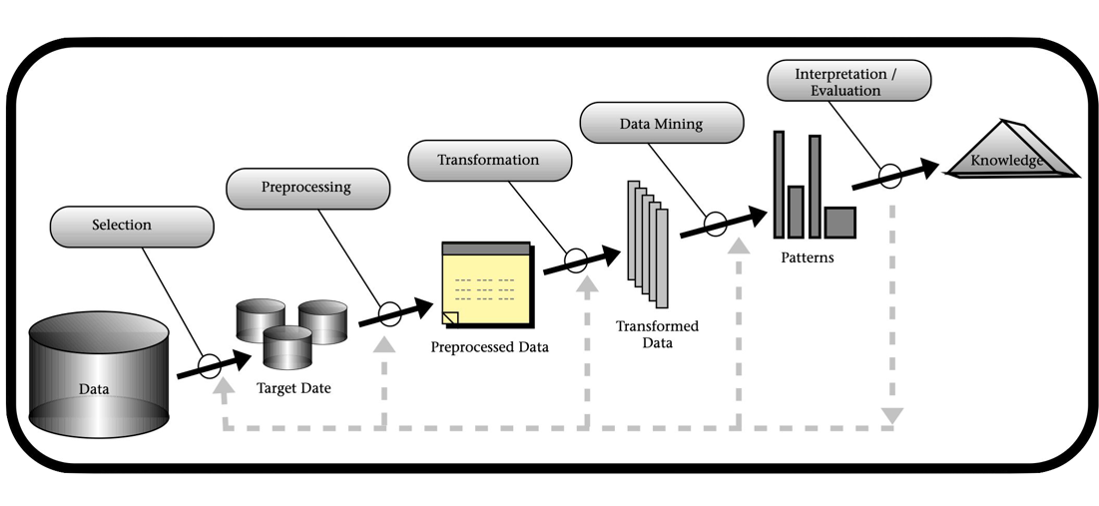
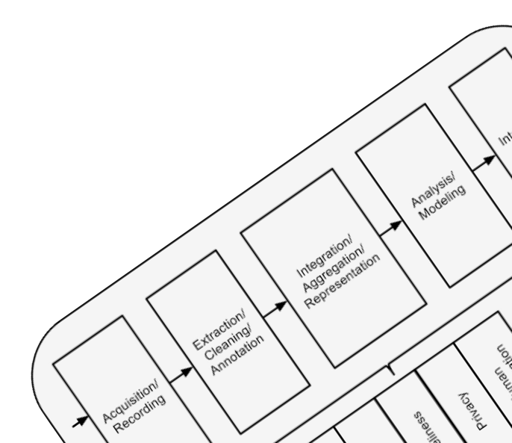
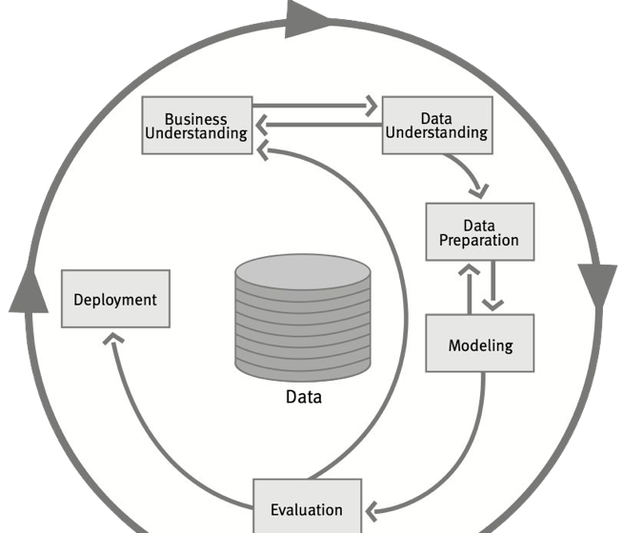
Post-hoc Explainers have Poor Fidelity
Explainability needs a process similar to: KDD, CRISP-DM or BigData.

Slide 19
Post-hoc Explainers have Poor Fidelity
Explainability needs a process similar to: KDD, CRISP-DM or BigData.
Engineers should spend time creating informative features and building inherently transparent models.
Bottom Line: It requires effort.

Slide 20

XAI Process
A generic eXplainable Artiﬁcial Intelligence Process is beyond our reach at the moment.
Attempts:
XAI Taxonomy spanning social and technical desiderata.
Sokol and Flach, 2020. Explainability Fact Sheets: A Framework for Systematic Assessment of Explainable Approaches.
Generic framework for black-box explainers.
Henin and Le Métayer, 2019. Towards a generic framework for black-box explanations of algorithmic decision systems.

Slide 21
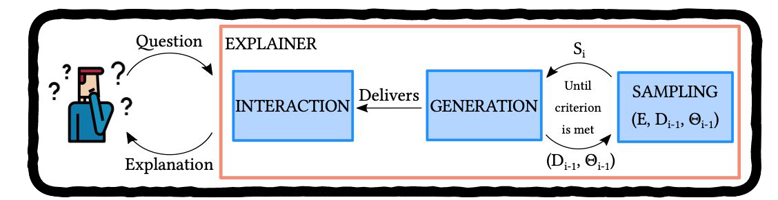
XAI Process
XAI Taxonomy spanning social and technical desiderata.
Functional | Operational | Usability | Safety | Validation
... | ... | ... | ... | ...
Generic framework for black-box explainers.

Slide 22
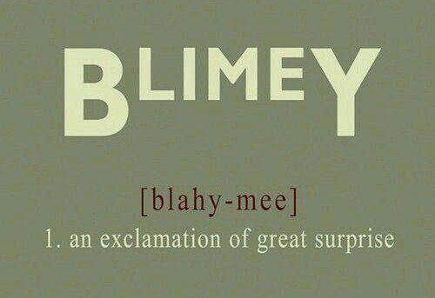
bLIMEy, there has to be a better way...
bLIMEy → build LIME yourself
Framework for building surrogate explainers.
Meta-algorithm for operationalising them.
Accompanied by analysis of surrogate building blocks (akin to a user guide).
Practical recommendations.
Good news: A means to build ﬂexible, faithful, interactive, ... surrogates.
Not so good news: It requires effort.
Sokol et al., 2019. bLIMEy: Surrogate prediction explanations beyond LIME

Slide 23
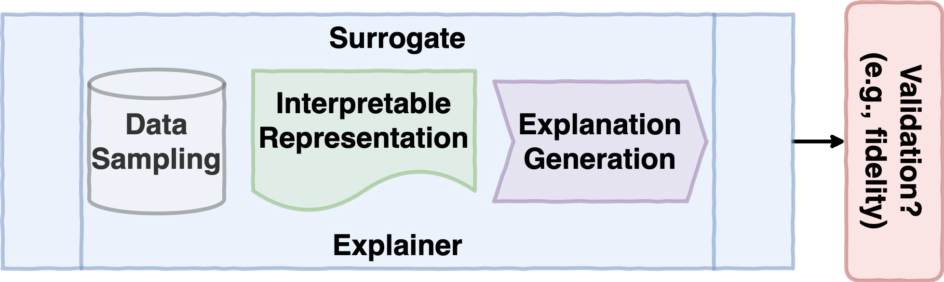
Building Blocks of Surrogate Explainers

Slide 24
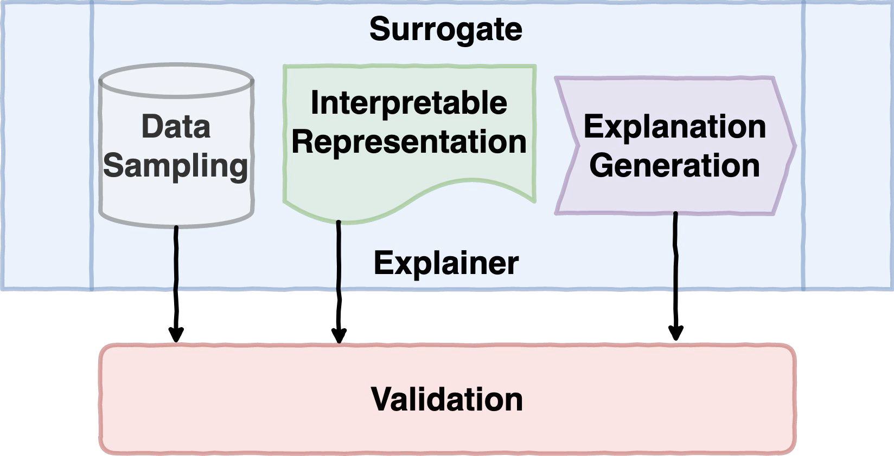
bLIMEy Framework

Slide 25
Operationalising Surrogates
We need to:
Understand where surrogates come from.
Know how to (correctly) interpret their explanations.
Then we should:
Analyse needed components and choose suitable algorithms.
Evaluate and validate them.
Ribeiro et al., 2016. "Why should I trust you?"
Explaining the predictions of any classiﬁer.

Slide 26
Surrogates for Text Data

Slide 27
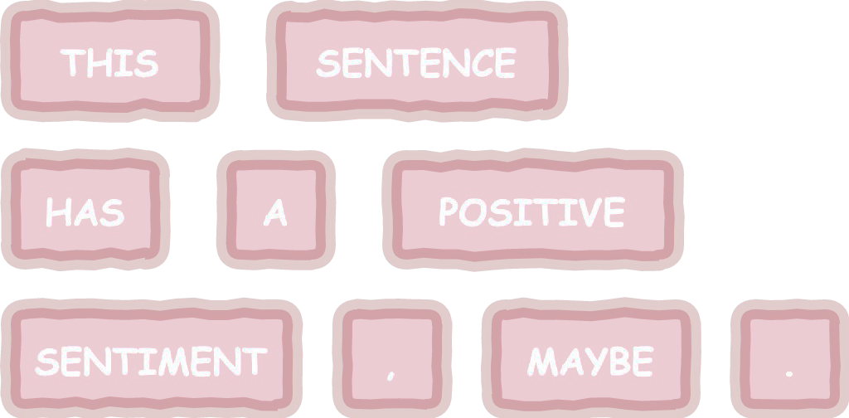
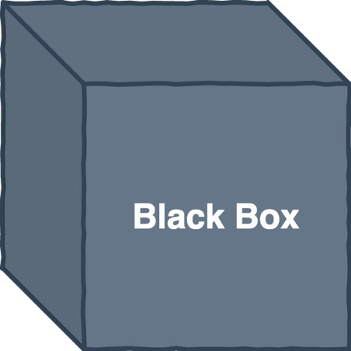

Black-box Prediction

Slide 28
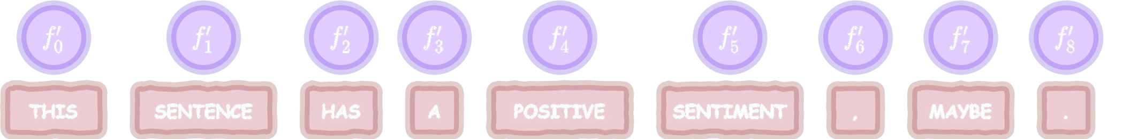
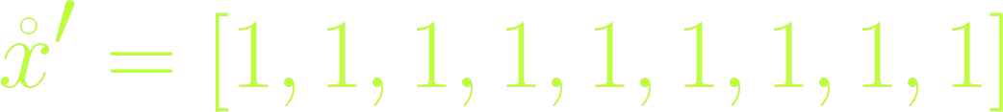
Interpretable Data Representation

Slide 29
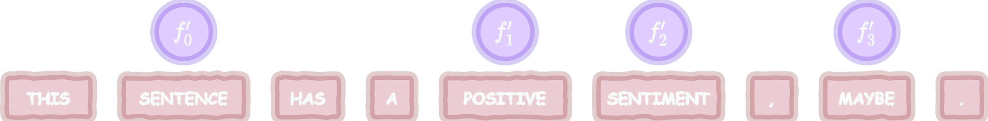
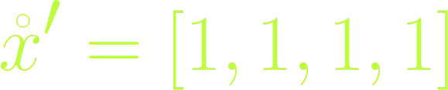
Interpretable Data Representation

Slide 30
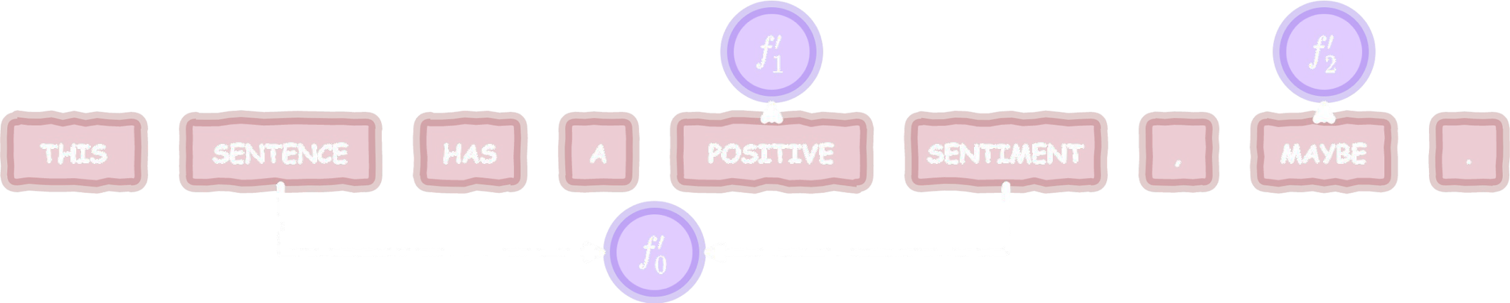
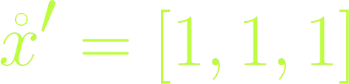
Interpretable Data Representation

Slide 31


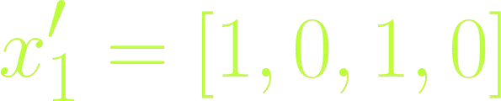
Data Sampling
Sampling from the original data domain is ill-deﬁned.
We have to sample from the interpretable representation.
randint(low=0, high=1, shape=(3, 4))

Slide 32
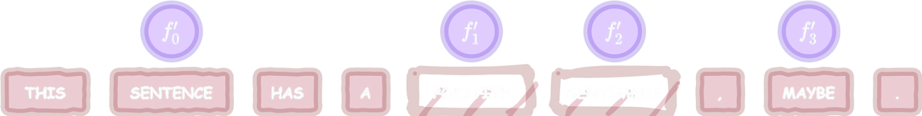

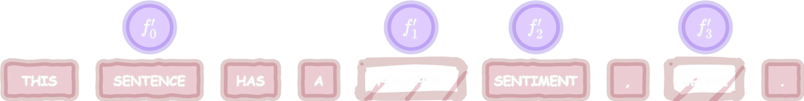
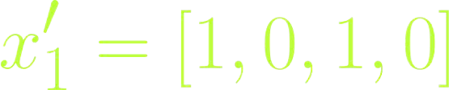
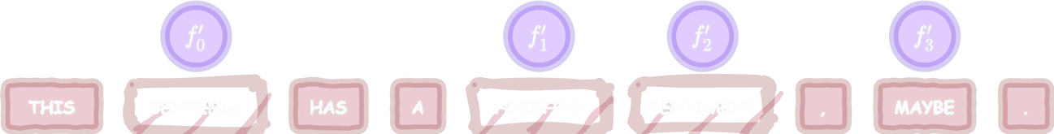
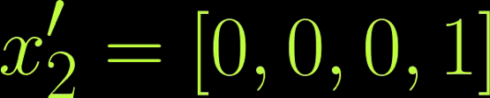
Explanation Generation -- Restoring Sample

Slide 33

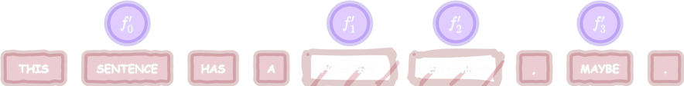
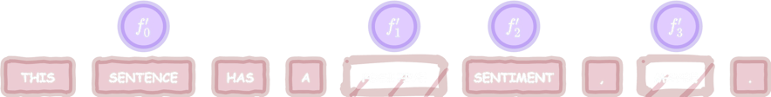

Explanation Generation -- Predicting Sample

Slide 34




Explanation Generation -- Weighting Sample
Distance
Similarity
d=2
d=2 d=3
s=0.62
s=0.62 s=0.23

Slide 35
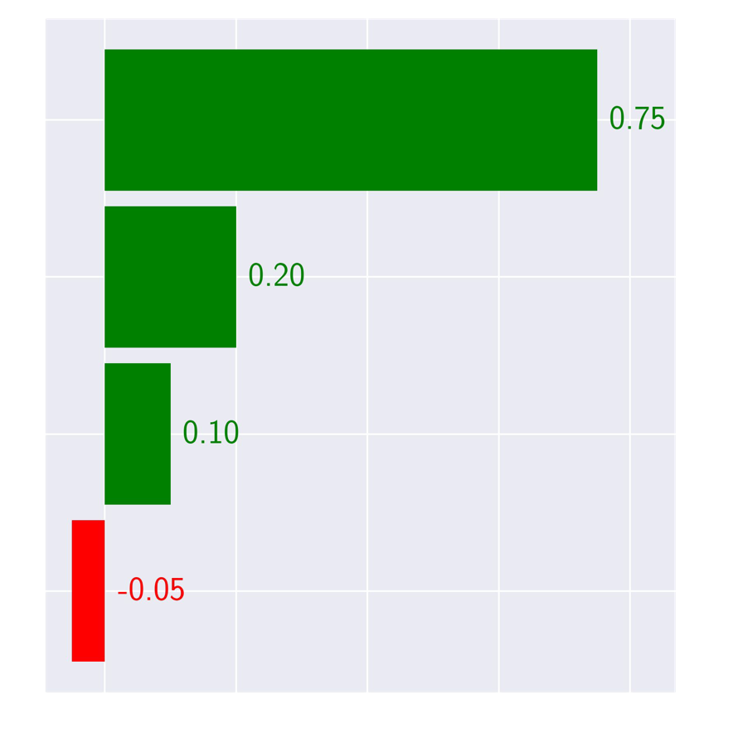
Explanation Generation -- Fitting Surrogate
Fit a sparse linear classiﬁer.
Use the binary vectors as data.
Use the black box-predictions for the sampled and reversed data as labels:
0 -- negative sentiment;
1 -- positive sentiment.
Weight instances according to the similarity scores.
Extract model coeﬃcients as
importance scores (explanation).

Slide 36
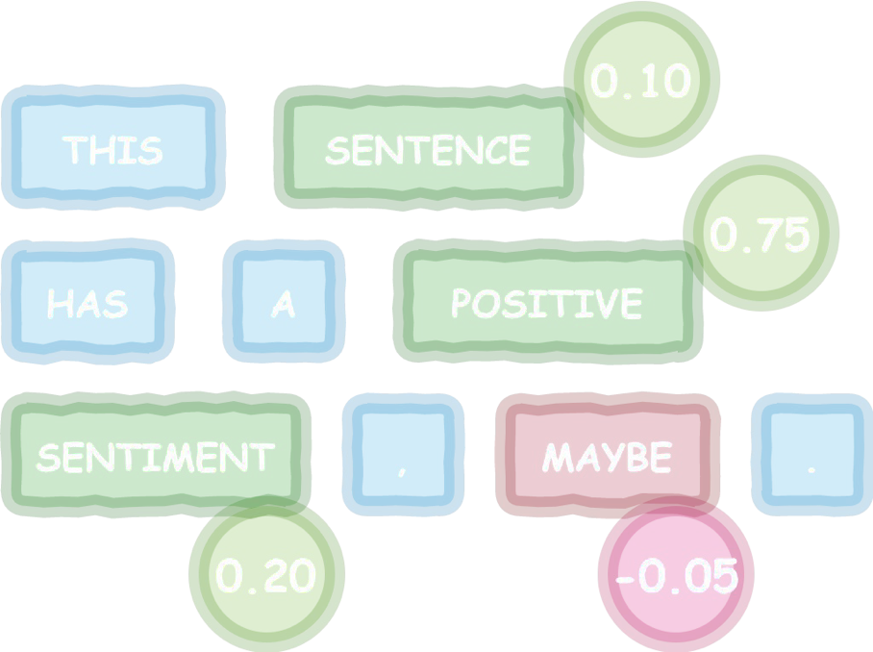
Explanation Generation -- Fitting Surrogate
Fit a sparse linear classiﬁer.
Use the binary vectors as data.
Use the black box-predictions for the sampled and reversed data as labels:
0 -- negative sentiment;
1 -- positive sentiment.
Weight instances according to the similarity scores.
Extract model coeﬃcients as
importance scores (explanation).

Slide 37
Surrogates for Image Data

Slide 38
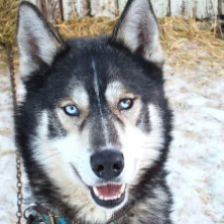
Black-box Prediction
husky/eskimo/malamute dog
HUSKY

Slide 39
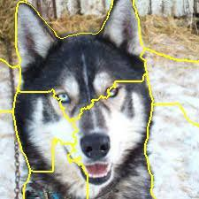
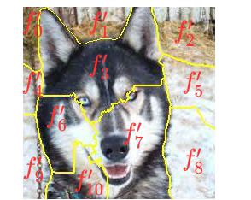
Interpretable Data Representation

Slide 40
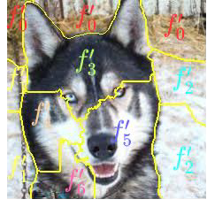
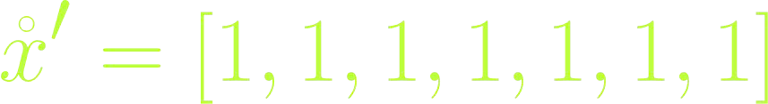
Interpretable Data Representation

Slide 41
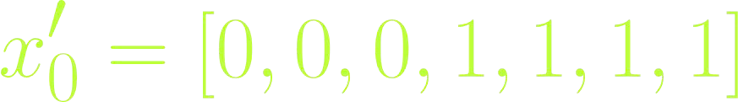
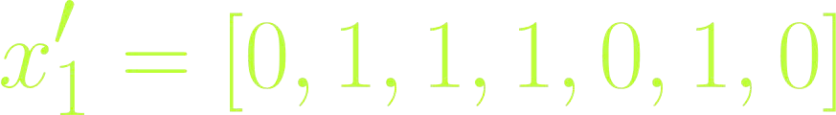
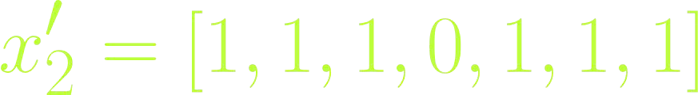
Data Sampling
Sampling from the original data domain is ill-deﬁned.
We have to sample from the interpretable representation.
randint(low=0, high=1, shape=(3, 7))

Slide 42
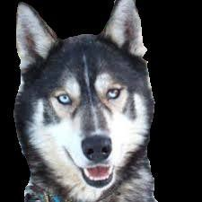
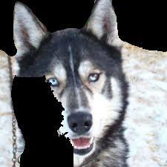
Explanation Generation -- Restoring Sample
How to remove super-pixels?
Using occlusion.

Slide 43
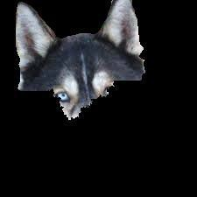
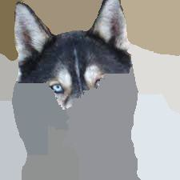
Explanation Generation -- Restoring Sample
What occlusion colour to use?
MALAMUTE
HUSKY

Slide 44
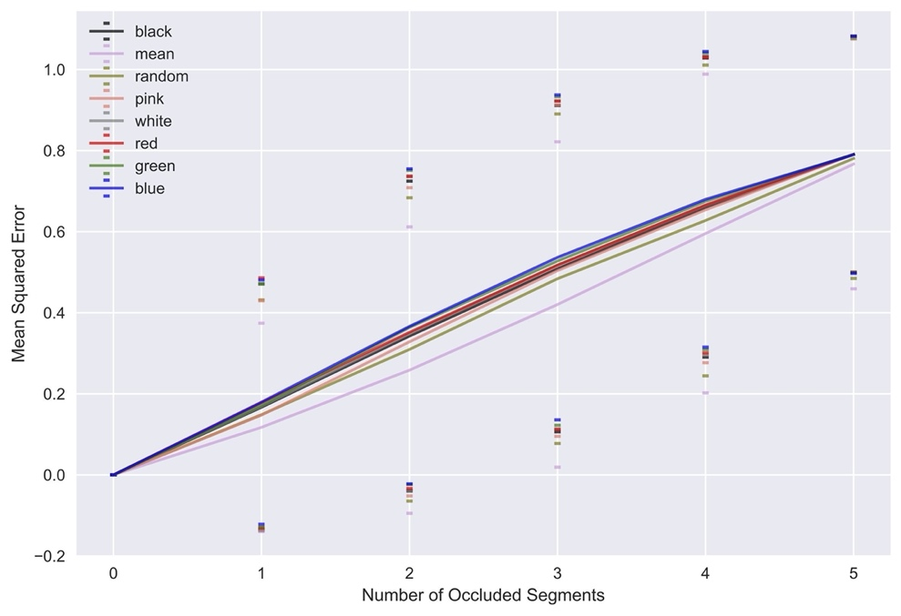
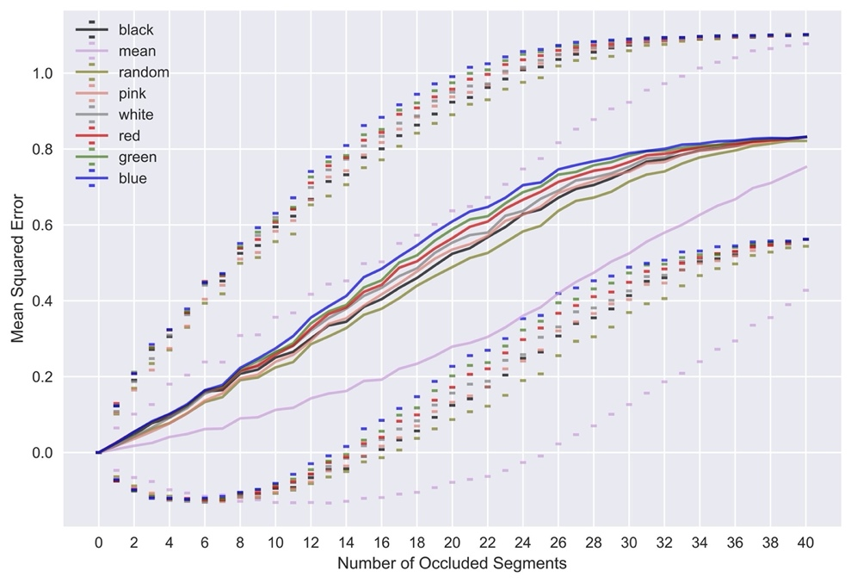
Explanation Generation -- Restoring Sample
What occlusion colour and segmentation granularity to use?
Sokol and Flach, 2020.Towards Faithful and Meaningful Interpretable Representations.

Slide 45

Explanation Generation -- Predicting Sample
MALAMUTE
HUSKY
ESKIMO

Slide 46




Explanation Generation -- Weighting Sample
Distance
Similarity
d=3
d=3 d=1
s=0.57
s=0.57 s=0.09

Slide 47

Explanation Generation -- Fitting Surrogate
Fit a sparse linear classiﬁer.
Use the binary vectors as data.
Use the black box-predictions for the sampled and reversed data as labels:
How for multi-class problems?
Weight instances according to the similarity scores.
Extract model coeﬃcients as
importance scores (explanation).

Slide 48

Explanation Generation -- Fitting Surrogate
Fit a sparse linear classiﬁer.
Use the binary vectors as data.
Use the black box-predictions for the sampled and reversed data as labels:
How for multi-class problems?
Weight instances according to the similarity scores.
Extract model coeﬃcients as
importance scores (explanation).

Slide 49

Explanation Generation -- Fitting Surrogate
Black box is a multi-class classiﬁer.
Surrogate is a (linear) binary classiﬁer.
Surrogate labels
MALAMUTE
HUSKY ESKIMO ESKIMO HUSKY
0
1
0
0
1
Explained Class:
HUSKY

Slide 50
Explanation Generation -- Fitting Surrogate
Black box is a probabilistic multi-class classiﬁer.
Surrogate is a (linear) regressor.
Surrogate target
.97
MALAMUTE
.06
MALAMUTE
.13
MALAMUTE
.11
MALAMUTE
.42
MALAMUTE
.01
HUSKY
.88
HUSKY
.23
HUSKY
.10
HUSKY
.58
HUSKY
.02
ESKIMO
.06
ESKIMO
.64
ESKIMO
.79
ESKIMO
.00
ESKIMO
.01
HUSKY
.88
HUSKY
.23
HUSKY
.10
HUSKY
.58
HUSKY
Explained Class:
HUSKY

Slide 51
Explanation Generation -- Fitting Surrogate
Black box is a probabilistic multi-class classiﬁer.
Surrogate is a (linear) regressor.
Surrogate target
.97
MALAMUTE
.06
.01 .02
HUSKY ESKIMO
.88 .06
.01
HUSKY
.88
HUSKY
.23
HUSKY
.10
HUSKY
.58
HUSKY
MALAMUTE
HUSKY
ESKIMO
Explained Class:
.13
.23
.64
MALAMUTE
.11
MALAMUTE
.42
HUSKY
.10
HUSKY
.58
ESKIMO
.79
ESKIMO
.00
HUSKY
MALAMUTE
HUSKY
ESKIMO

Slide 52

Explanation Generation -- Fitting Surrogate
Black box is a probabilistic multi-class classiﬁer.
Surrogate is a multi-output regressor (tree).
Surrogate target
.97
MALAMUTE
.06
MALAMUTE
.13
MALAMUTE
.11
MALAMUTE
.42
MALAMUTE
.01
HUSKY
.88
HUSKY
.23
HUSKY
.10
HUSKY
.58
HUSKY
.02
ESKIMO
.06
ESKIMO
.64
ESKIMO
.79
ESKIMO
.00
ESKIMO
.01
HUSKY
.88
HUSKY
.23
HUSKY
.10
HUSKY
.58
HUSKY
.02
ESKIMO
.06
ESKIMO
.64
ESKIMO
.79
ESKIMO
.00
ESKIMO
Explained Classes:
HUSKY
ESKIMO
Sokol and Flach, 2020. LIMEtree: Interactively Customisable Explanations Based on Local Surrogate Multi-output Regression Trees.

Slide 53
Surrogates for Tabular Data

Slide 54


Black-box Prediction
red/grey
RED

Slide 55


















Interpretable Representation: (Q) Discretisation

Slide 56






Interpretable Representation: (Q) Binarisation

Slide 57
Interpretable Representation: (Q) Complexity
What happens in higher dimensions?
Discrete → exponential growth of partitions -- n^{d}, e.g., 4²=16 for quartile discretisation in our toy example.
Original data with d numerical features.
Each numerical feature split into n sectors.
Categorical attributes not affected.
Binary → reduces this number to 2^{d}, e.g., 2²=4 for binarisation of our toy example.
Sparsity problem -- 11 numerical features yield 4¹¹=4,194,304 hyper-rectangles and 2¹¹=2,048 binary encodings.

Slide 58



Interpretable Representation: (★) Purity
Imagine this is a sample around the explained data point.
The colour of markers encodes a class predicted by a black box.
Pure hyper-rectangles imply good approximation of a black-box boundary.

Slide 59
Interpretable Representation: (★) Purity
Purity score weighted by the number of instances in each partition:
crisp classiﬁcation → Gini Index/Impurity;
probabilistic classiﬁcation or regression → Mean Squared Error.

Slide 60






Interpretable Representation: (T) Discretisation

Slide 61





Interpretable Representation: (T) Binarisation

Slide 62



Data Sampling
Sample from:
binary interpretable representation
discrete intermediate representation
original data domain
randint(low=0, high=1,
shape=(3, 2))
randint(low=0, high=3,
shape=(3, 2))
...

Slide 63




Data Sampling: Interpretable (Binary)

Slide 64




Data Sampling: Intermediate (Discrete)

Slide 65


Data Sampling: Original
Normal
Truncated Normal

Slide 66


Data Sampling: Original (ctd.)
Class Discovery
Mixup
Zhang et al., 2017. mixup: Beyond empirical risk minimization.

Slide 67


Data Sampling -- Comparison
Diverse sample → good chance of approximating
black-box decision boundary.
(Whereas interpretable representation should be as pure as possible.)
Binary/discrete sampling, in principle, discover classes as they are somewhat global. (Caveat: large number of hyper-rectangles to sample from.)
Original data domain sampling must explicitly discover the neighbourhood.

Slide 68





Explanation Generation -- Restoring Sample
Only required for binary and discrete sampling.

Slide 69

Explanation Generation -- Restoring Sample
Only required for binary and discrete sampling.

Slide 70





Explanation Generation -- Weighting Sample
But in which domain?
Discrete
Binary
Original

Slide 71


Explanation Generation -- Weighting Sample
Kernelisation...
But in which domain?
Discrete Distances
Kernelisation

Slide 72


Explanation Generation -- Feature Selection
Not required for image and text data -- the explanation presentation is as intelligible as the explained instance.
Can be computed for any representation, but applies to the binary interpretable -- introducing sparsity to the bar plot.
lasso path;
forward selection; and
highest weights.
Interpretable representations based on tree splits have sparsity mechanisms built in (e.g., impurity reduction and pruning).

Slide 73


Linear Surrogate + Discretisation/Binarisation
Caveats: feature independence and linearity.
Sokol and Flach, 2020.Towards Faithful and Meaningful Interpretable Representations.

Slide 74


Linear Surrogate with One-hot Tree Features
Caveats: feature independence, linearity, possible rule overlap.

Slide 75



End-to-end Tree-based Surrogate
Caveats: axis-parallel splits.

Slide 76

You Need to Choose Wisely
There is no magic formula -- it takes in-depth understanding and effort.

Slide 77


Reproducibility
FAT Forensics
Fairness, Accountability and Transparency software
https://fat-forensics.org/
https://joss.theoj.org/papers/10.21105/joss.01904
Hands-on surrogate explainability
https://events.fat-forensics.org/2020_ecml-pkdd
More educational resources and modular implementations arriving next year.

