Slide 1



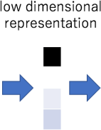
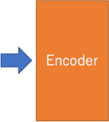
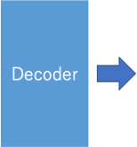
Exploi'ng Auto-Encoders for Explaining Black Box Classiﬁers
Riccardo Guidotti

Slide 2

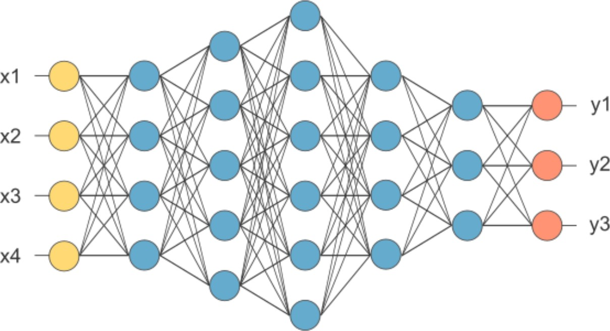
What is a Black Box Model?
A black box is a model, whose internals are either unknown to the observer or they are known but uninterpretable by humans.
Example:
DNN
SVM
Ensemble
- Guidotti, R., Monreale, A., Ruggieri, S., Turini, F., Giannotti, F., & Pedreschi, D. (2018). A survey of methods for explaining black box models. ACM Computing Surveys (CSUR), 51(5), 93.

Slide 3
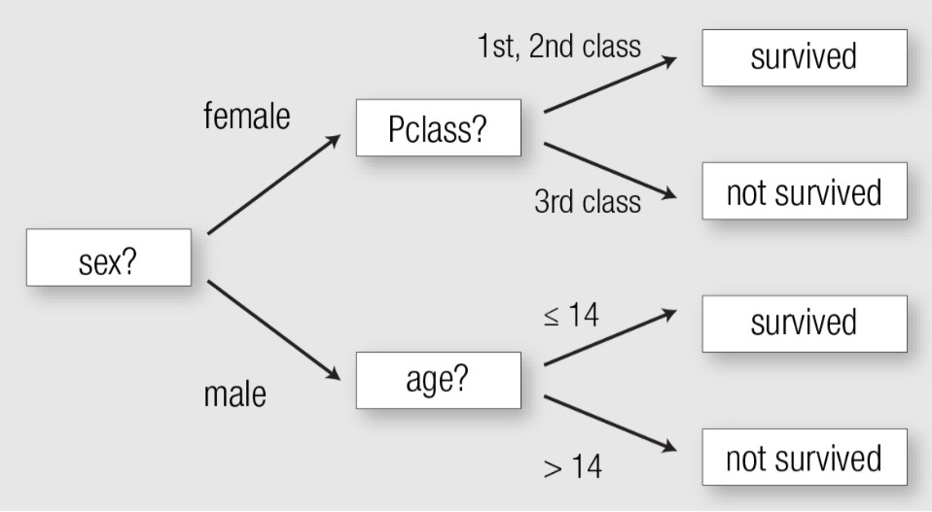
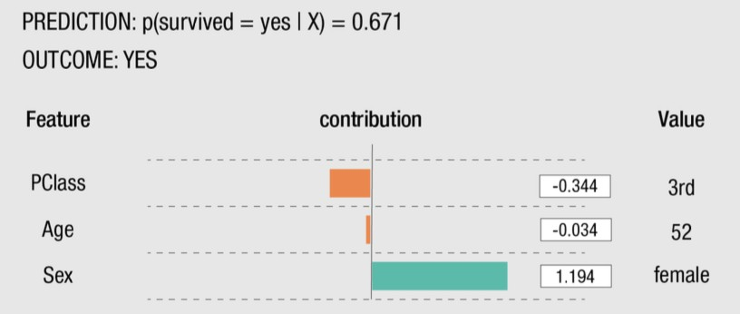
Interpretable Models
Decision Tree
Linear Model
Rules

Slide 4

How to Open the Black Box

Slide 5
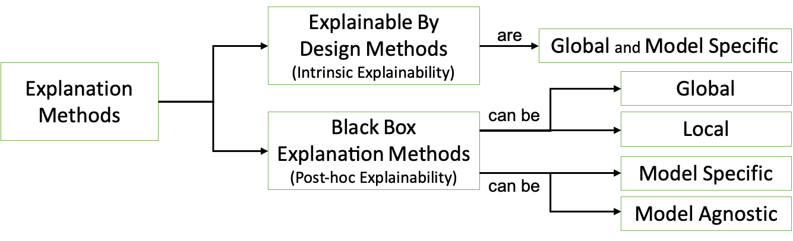
XAI Taxonomy of Explana>on Methods

Slide 6
XAI Taxonomy of Explanation Methods

Slide 7
XAI Taxonomy of Explanation Methods
Black-box System
𝑦!
Input Data
Interpretability Transparent System
Black-box AI System
𝑦!
Input Data
Explana'on
Explanation Sub-system

Slide 8
XAI Taxonomy of Explanation Methods

Slide 9
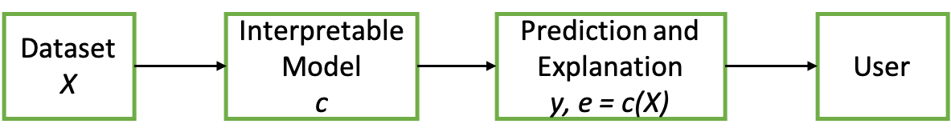
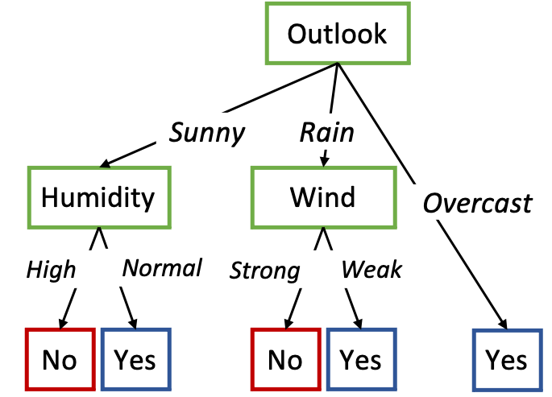
Explainable by Design Method

Slide 10
XAI Taxonomy of Explanation Methods

Slide 11
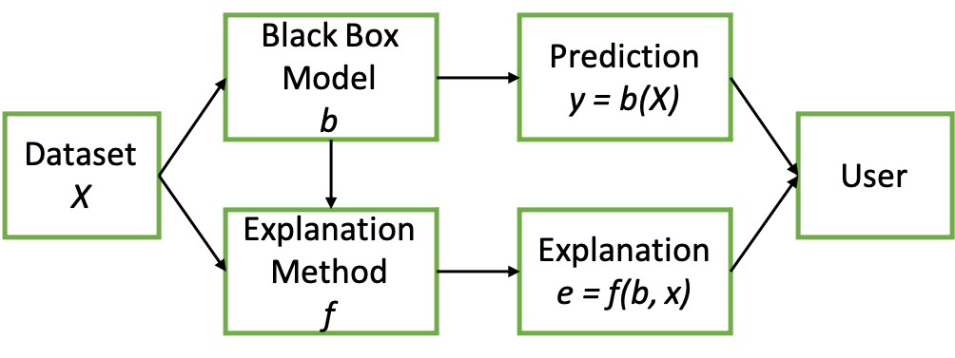
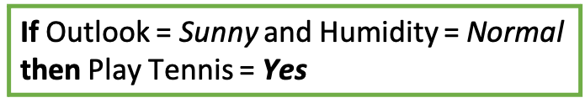
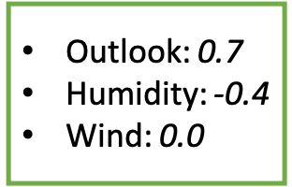
Black Box Explana>ons: Global vs Local
Global Explanation
Local Explanations

Slide 12
XAI Taxonomy of Explana>on Methods

Slide 13
Black Box Explana>ons: Speciﬁc vs Agnos>c
Model Specific
f is black box dependent
Model Agnos7c
f is black box independent

Slide 14

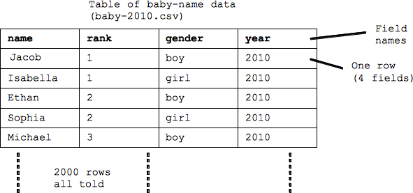

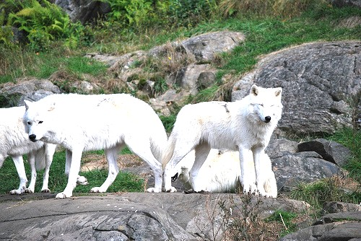
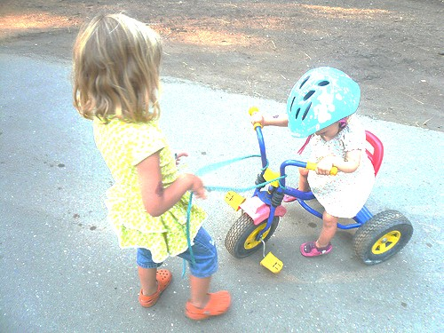
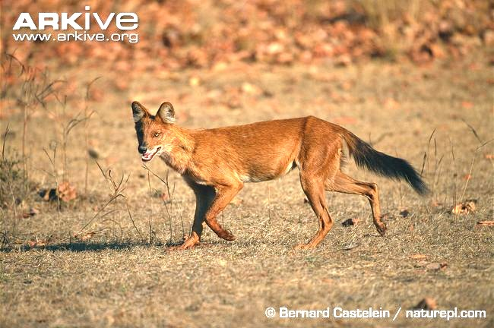
Types of Data
Images (IMG)
Tabular (TAB)
Text (TXT)

Slide 15

Background and Motivations

Slide 16
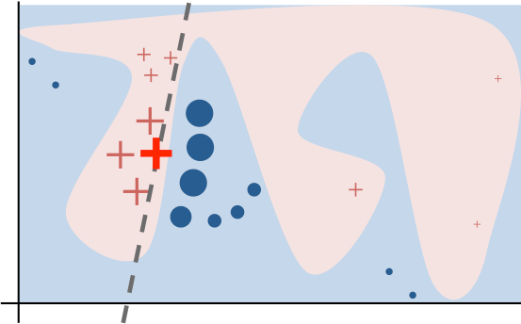
Local Explana>on
The overall decision boundary is complex
In the neighborhood of a single decision, the boundary is simple
A single decision can be explained by auditing the black box around the given instance and learning a local decision.

Slide 17
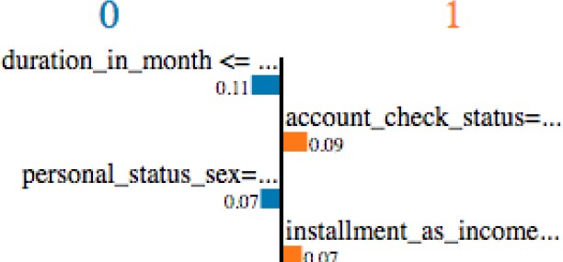
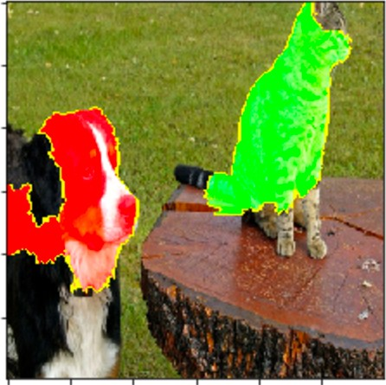
Local Interpretable Model-agnos>c Explana>ons
Local model-agnostic explainer that reveals the black box decisions through features importance/saliency maps.
It locally approximates the behavior of a black box with a local surrogate expressed as a logistic regressor (with Lasso or Ridge penalization).
Synthetic neighbors are weighted w.r.t. the distance with the instance to explain.

Slide 18
LIME on Tabular Data
Sepal length | Sepal width | Petal length | Petal width | b(setosa) | b(versic) | b(virgi)
3 | 4 | 3 | 6 | 0.1 | 0.7 | 0.2
3 4 5 6 0.4 0.4 0.6
3 2 3 8 0.3 0.6 0.1
5 2 3 6 0.0 0.3 0.7
2 4 4 7 0.0 0.8 0.2
Train a Logis1c Regressor
Returns the coeﬃcients as Explana1on

Slide 19
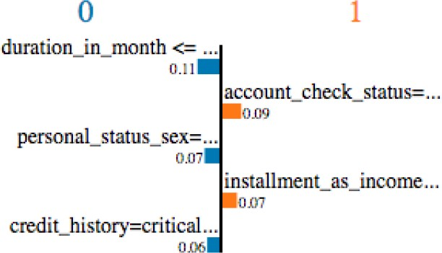
LIME Pseudo - Code
Features Importance
01
02
03
04
05
06
07
08
09
Z = {}
x instance to explain x’
= real2interpretable(x)
for i in
{1, 2, …, N}
z_{i}= sample_around(x’) interpretabel2real(z’)
Saliency Map
z =
Z = Z ∪ {<z_{i}, b(z_{i}), d(x, z)>}
w = solve_Lasso(Z, k)
return w
black box audi,ng
- Marco Tulio Ribeiro, Sameer Singh, and Carlos Guestrin. 2016. Why should i trust you?: Explaining the predictions of any classifier. KDD.

Slide 20
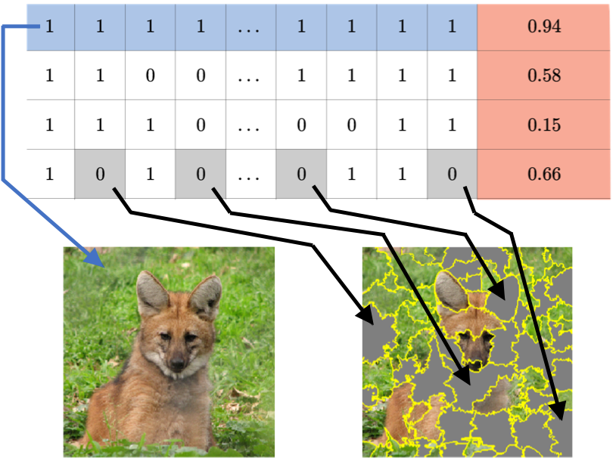
LIME on Images
x'
z'
LIME turns an image x to a vector x’ of interpretable superpixels expressing presence/absence.
It generates a synthe=c neighborhood Z by randomly perturbing x’ and labels them with the black box.
It trains a linear regression model (interpretable and locally faithful) and assigns a weight to each superpixel.
x
z

Slide 21
LIME Issues
?
?
?
LIME does not really generate images with diﬀerent informaHon: it randomly removes some superpixels, i.e. it suppresses the presence of an informaHon rather than modifying it.
On tabular data LIME generates the neighborhood by changing the feature values with other values of the domain.
x = {age=24, sex=male, income=1000} ( x = x’)
z = {age=30 , sex=male, income=800} ( z = z’)
A set of values with weights (both for images and tabular data) is not necessarily a good and human comprehensible explanaHon

Slide 22
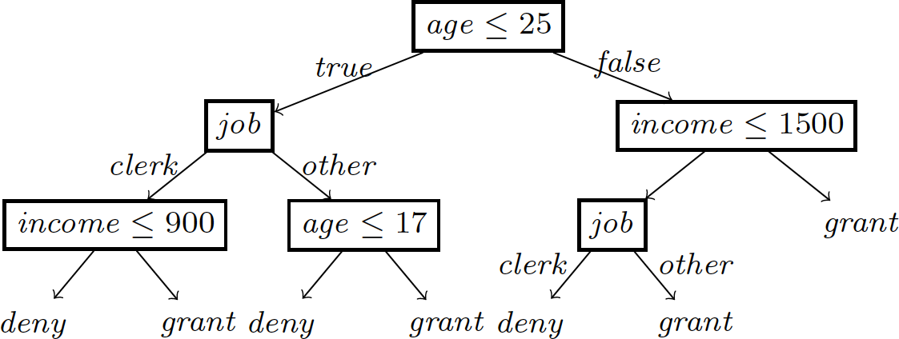


LORE: LOcal Rule-based Explainer
LORE extends LIME adop1ng as local surrogate a decision tree classiﬁer and by genera1ng synthe1c instances through a gene1c procedure that accounts for both instances with the same labels and diﬀerent ones.
It can be generalized to work on images and text using the same data representa1on adopted by LIME.

Slide 23
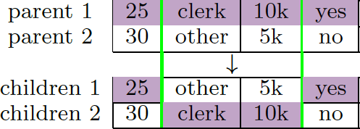
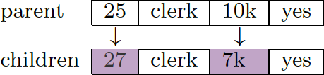
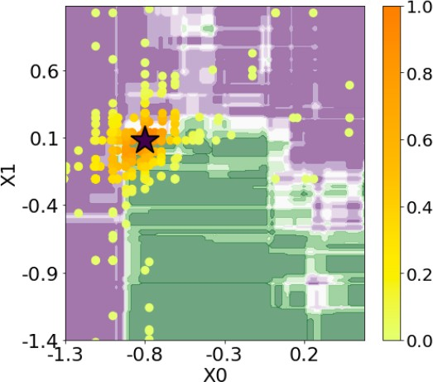

LORE Pseudo - Code
01 x instance to explain 02 Z₌
Z≠
Z
c
r
ϕ
return e = <r, ϕ>
= geneticNeighborhood(x,
= geneticNeighborhood(x,
=
=
=
=
fitness₌, fitness≠,
N/2) N/2)
Z₌ ∪ Z≠
black box auditing
buildTree(Z, b(Z))
(p -> y) = extractRule(c, x)
r,
extractCounterfactual(c,
x)
r = {age ≤ 25, job = clerk, income ≤ 900} -> deny
Φ = {({income > 900} -> grant),
({17 ≤ age < 25, job = other} -> grant)}

Slide 24
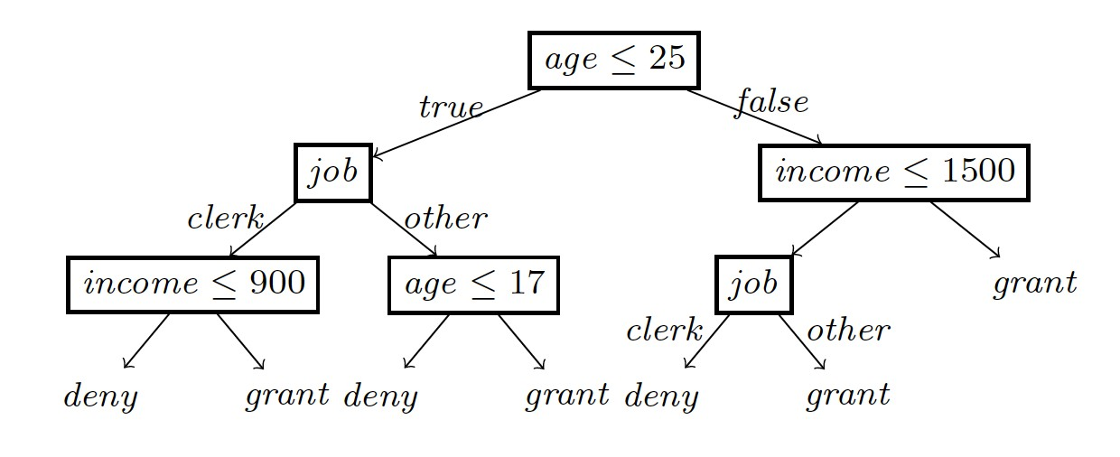
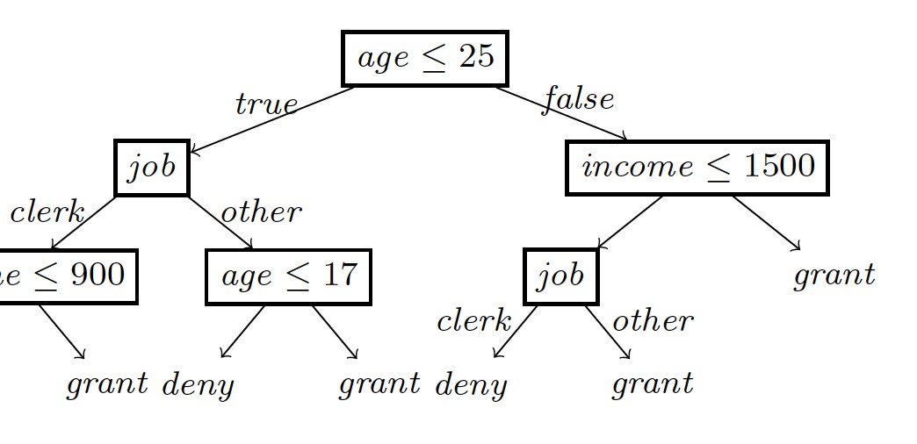
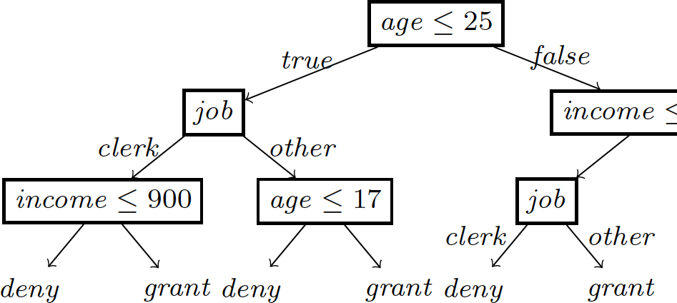


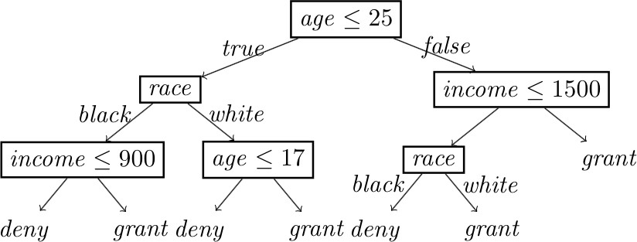

LOREsa: Stable and Ac>onable LORE
Data-driven merge of decision trees for stabilizing local neighborhood
Actionable counterfactual rules extraction

Slide 25
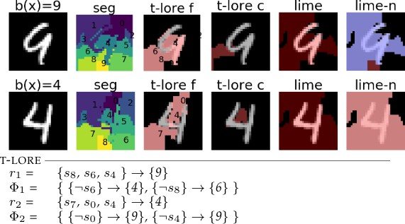
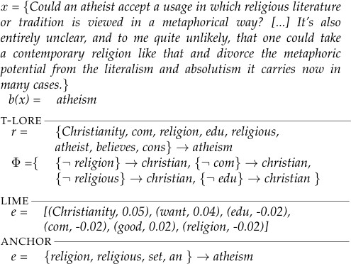
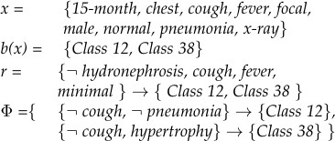
LORE for Images, Text, and Mul>label Data

Slide 26
Explaining with Autoencoders

Slide 27
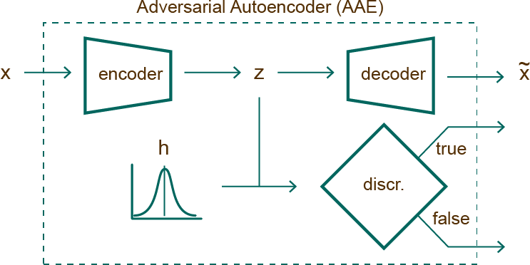


Adversarial Autoencoder
.1 | .2 | .2 | .5

Slide 28

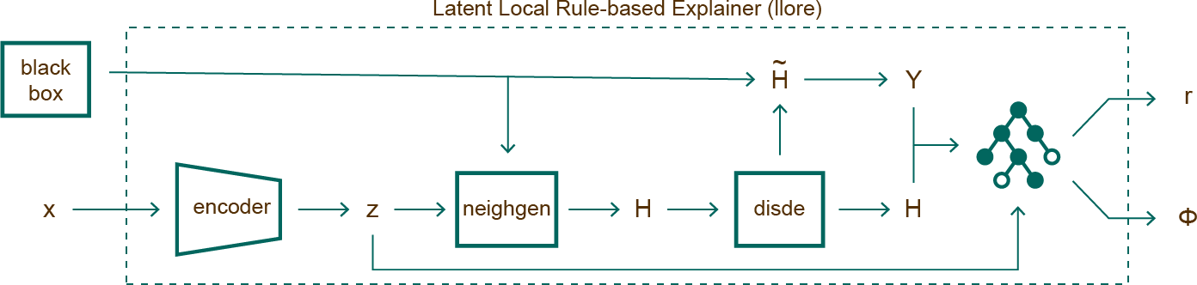


Latent Local Rule Extraction
0
4
0
0
.1 | .2 | .2 | .5
.2 | .1 | .3 | .6
.2 | .2 | .3 | .5
.1 | .3 | .1 | .4
.1 | .2 | .2 | .5
r = if z₁ > 0.1 and z₃ ≤ 0.5 then ‘0’
Φ = {({z₁ ≤ 0.1} --> ‘4’), ({z₃ > 0.5} --> ‘8’)}
Guidotti, Riccardo, et al. Black Box Explanation by Learning Image Exemplars in the Latent Feature Space. ECML-PKDD, 2019.

Slide 29
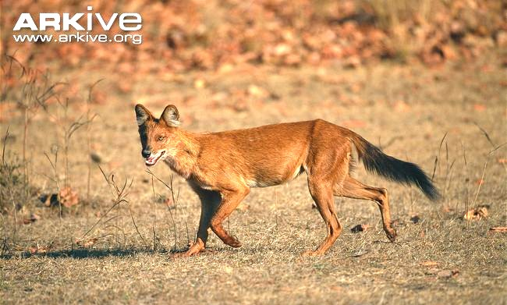
ABELE: Explaining Image Classifiers

Slide 30
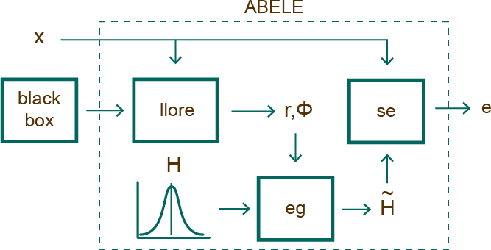





ABELE: Adversarial Black box Explainer genera7ng Latent Exemplars
Guidotti, Riccardo, et al. Black Box Explanation by Learning Image Exemplars in the Latent Feature Space. ECML-PKDD, 2019.

Slide 31
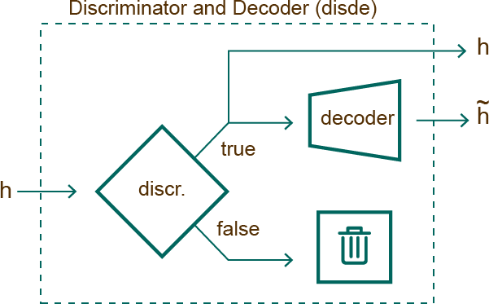
Discriminator and Decoder
The Discriminator and Decoder (disde) checks the validity of h by querying the discriminator and decoding it into its real representaHon.
.1 | .2 | .2 | .5
.1 | .2 | .2 | .5

Slide 32
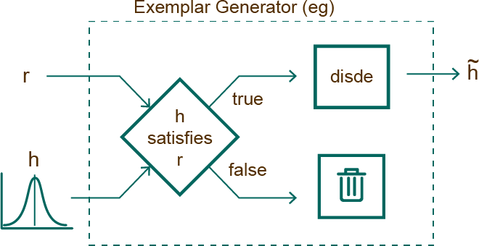
Exemplar Generator
Exemplars and counter- exemplars are similar to x, leading to an equal or diﬀerent outcome of b(x).
It randomly generates a set of latent instances H saHsfying the decision rule r, or counter- factual rules ȹ. Then, it validates and decodes them.

Slide 33
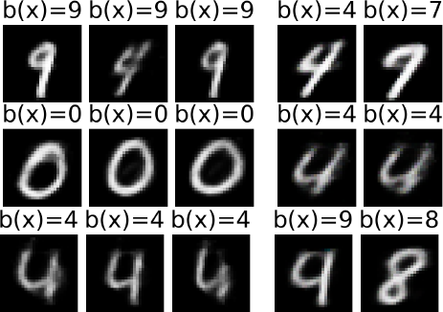
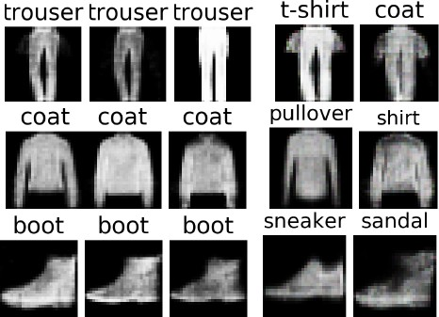
Exemplars and Counter-Exemplars
mnist ● fashion

Slide 34

Saliency Map from Exemplars
Red/Blue means consistent diﬀerence “variable area”
The saliency map s highlights areas of x that contribute to b(x) and that push it to ≠ b(x).
It is obtained as follows:
pixel-to-pixel-difference between x and each exemplar in H
each pixel of s is the median value of the differences calculated for that pixel.
Yellow means no difference “no change area”

Slide 35
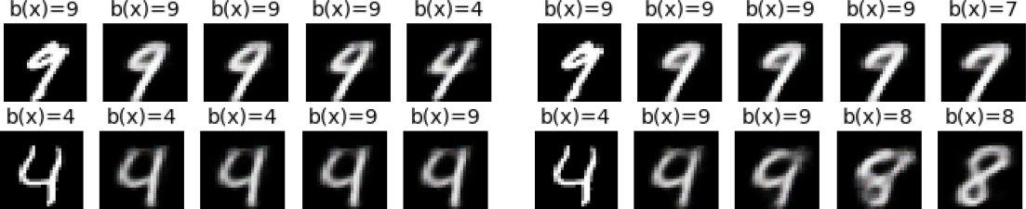
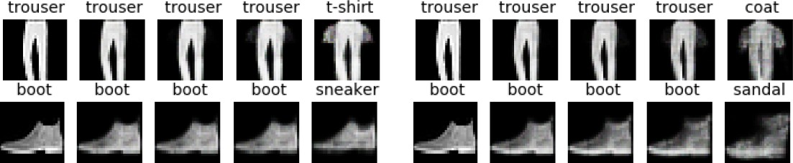
From Image to Counter-Exemplar
T. Spinner et al. Towards an interpretable latent space: an intuitive comparison of autoencoders with variational autoencoders. In IEEE VIS 2018, 2018.
mnist
fashion

Slide 36
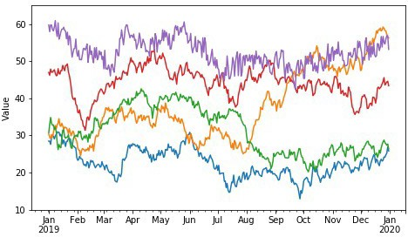
LASTS: Explaining Time Series Classiﬁers

Slide 37
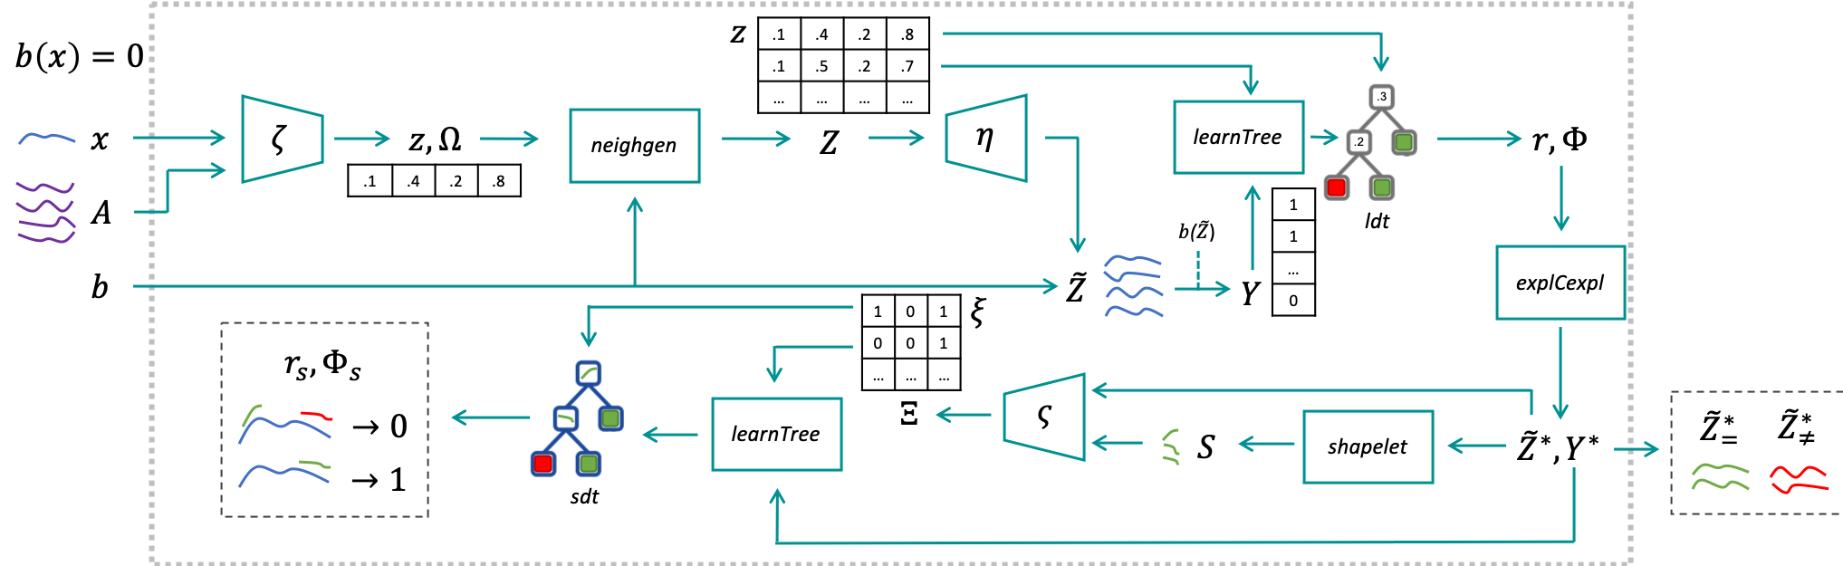
LASTS: Local Agnostic Shapelet-based Time Series explainer

Slide 38
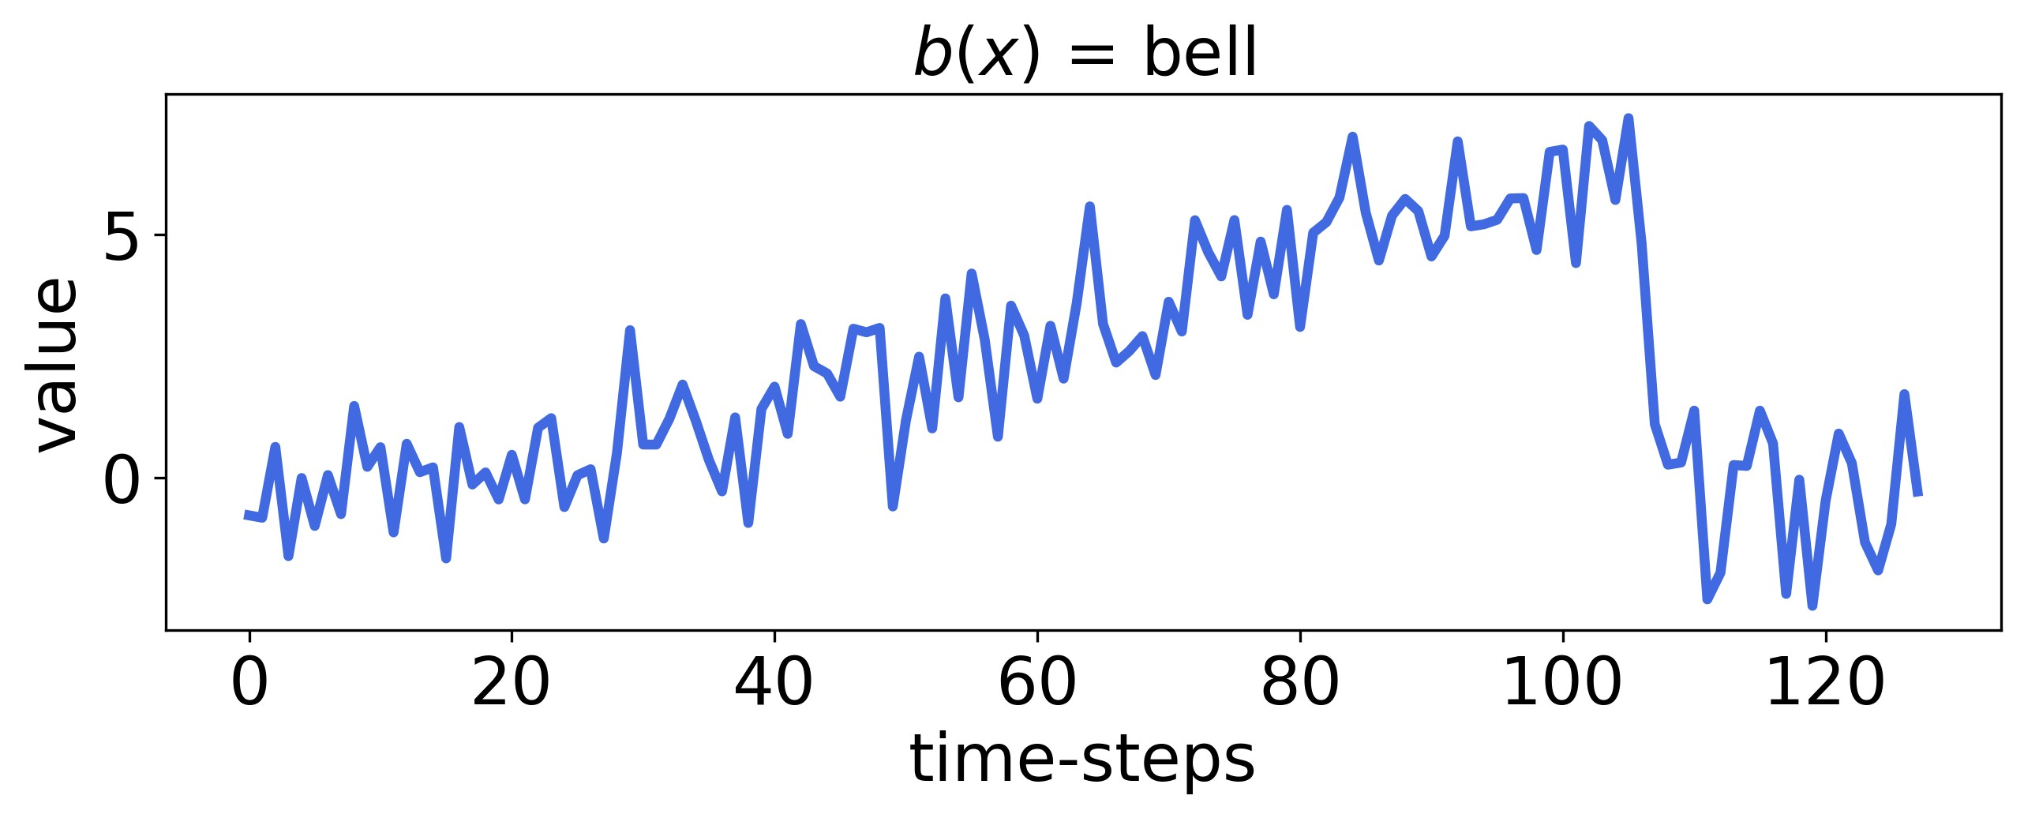
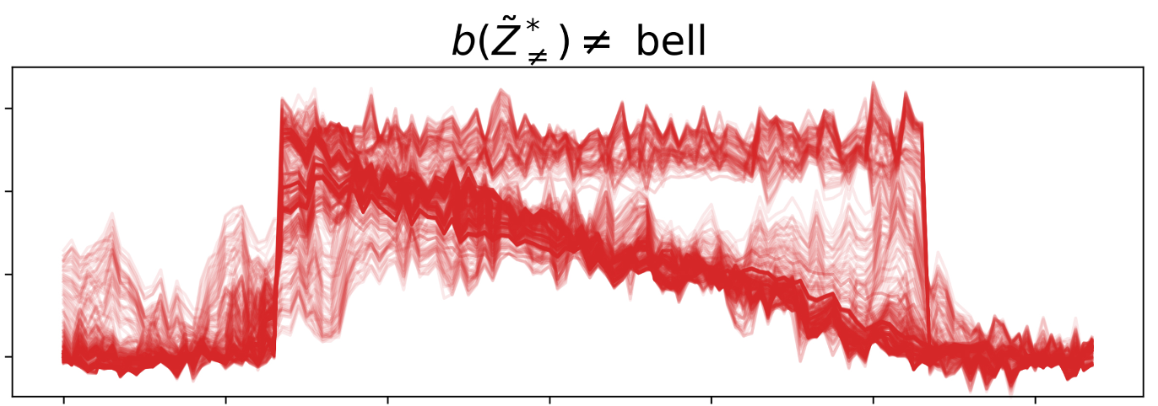
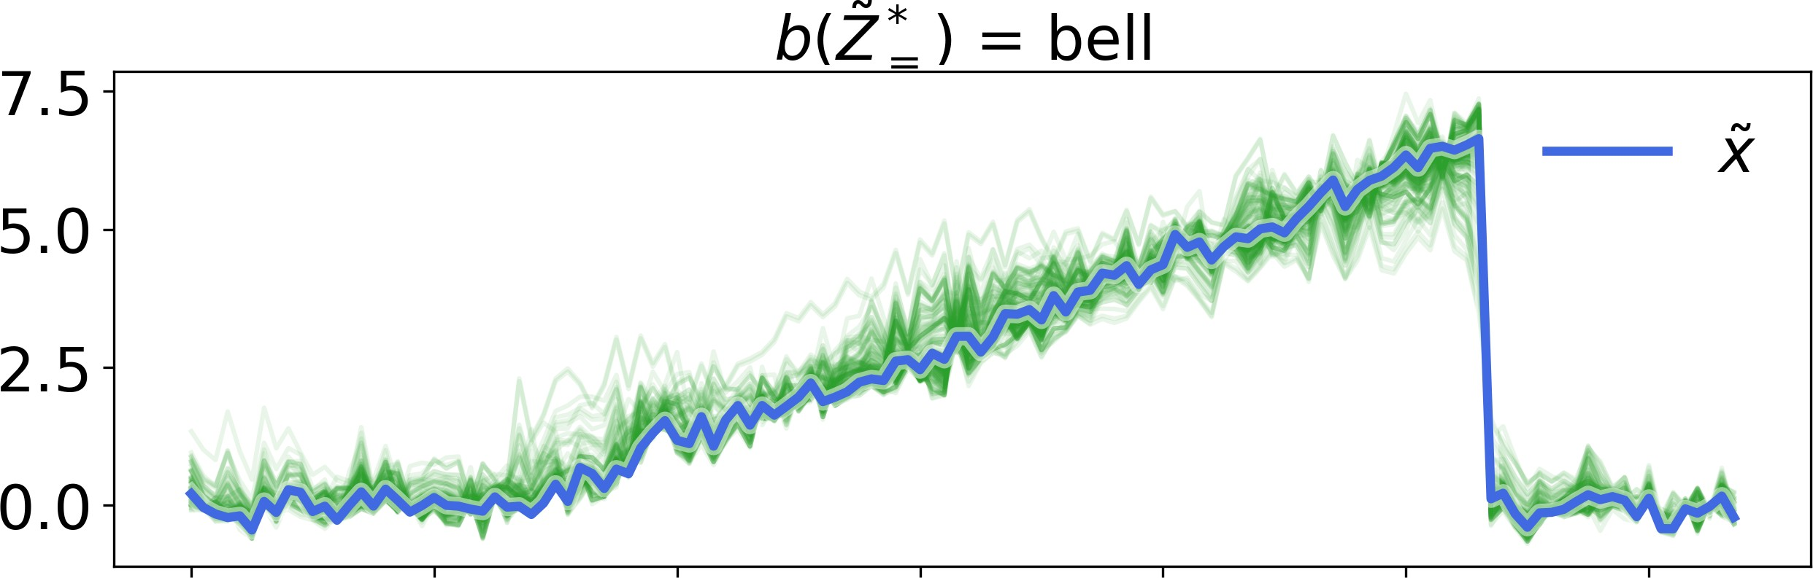
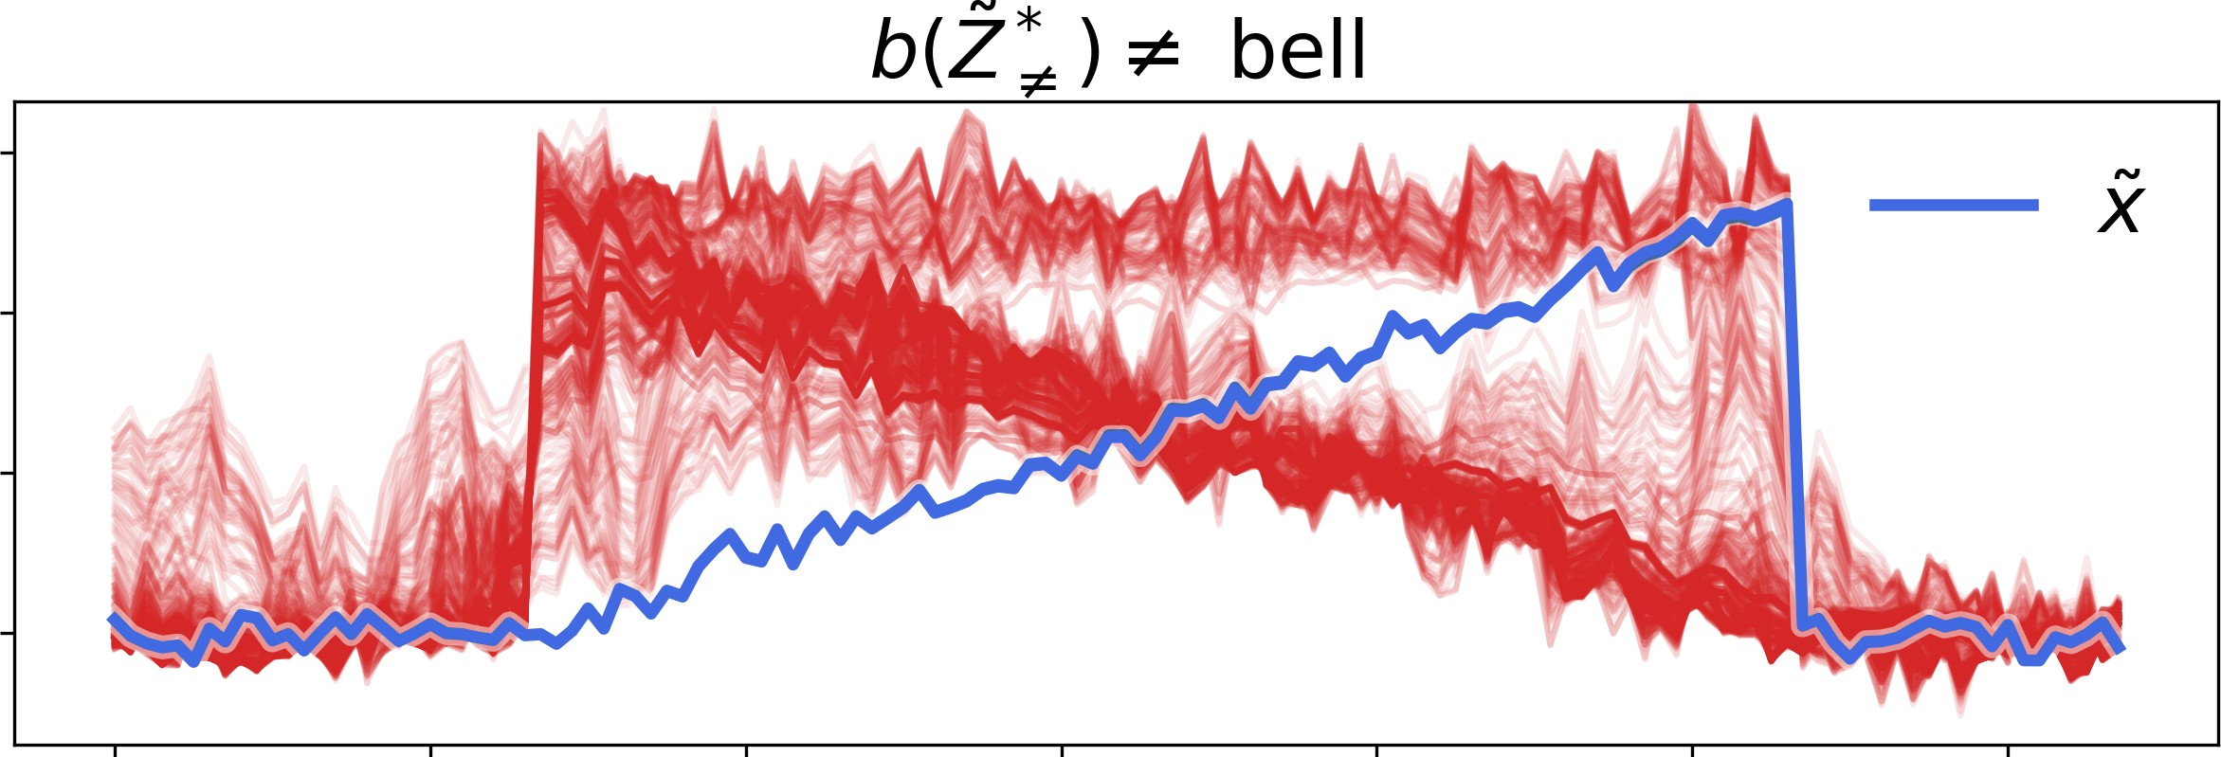
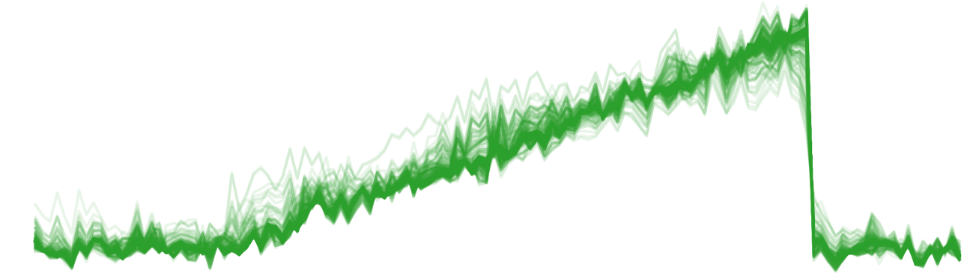
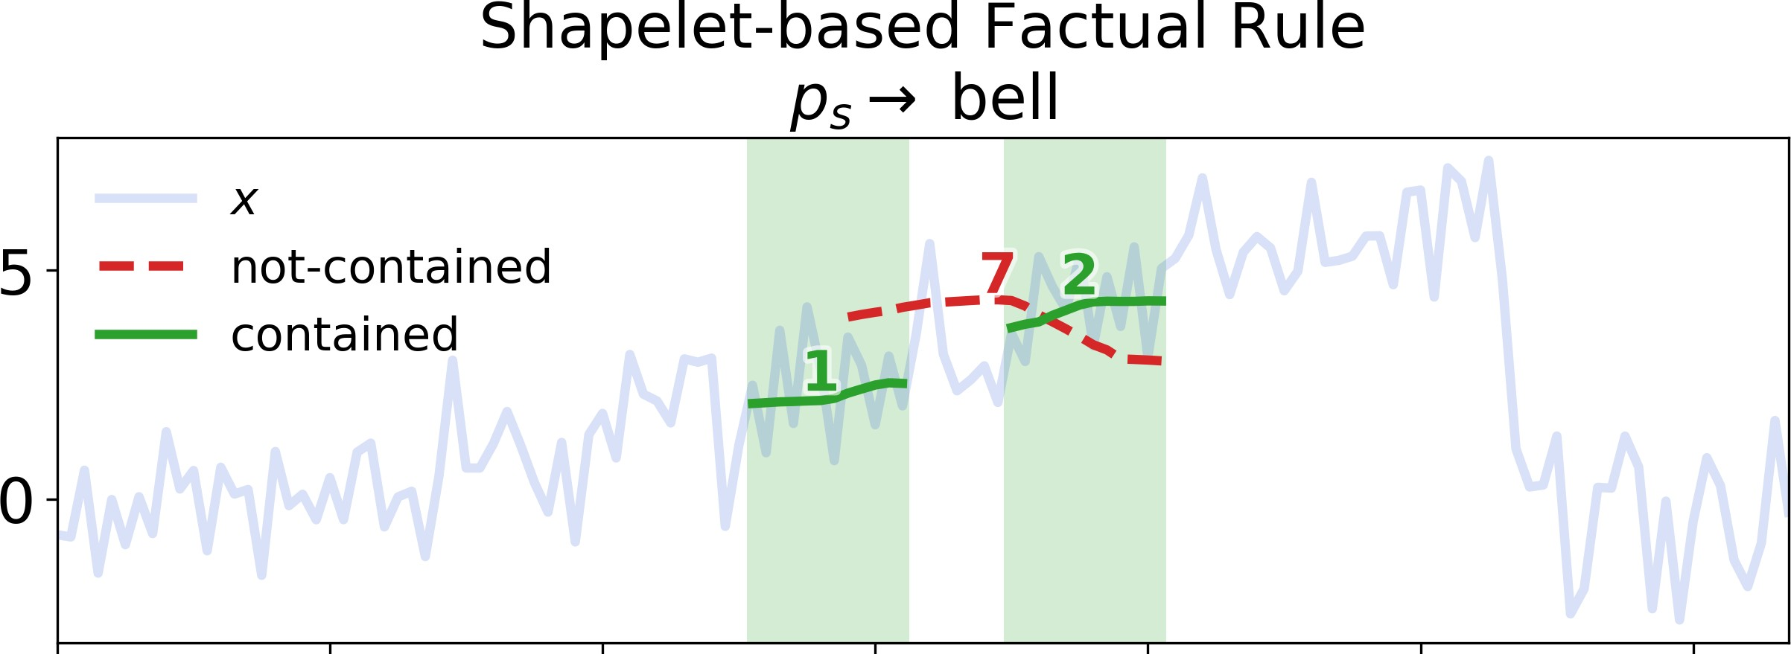

LASTS Explana,on
Instance to explain
Exemplars
Counter-Exemplars
Factual Rule
Counter-Factual Rule

Slide 39




Exemplars and Counter Exemplars

Slide 40

From Exemplars to Counter-Exemplars

Slide 41




Shapelet-Based Rule Extrac>on
⟨1, 1, 1, 1, 0, 1, 0, 0, 1, 0⟩
r_{s}
IF s7 is NOT contained AND
s1 AND s2 are contained
bell
IF s2 AND s7 are NOT contained
Φ_{s} AND s1 is contained
funnel

Slide 42
XSPELLS: Explaining Text Classiﬁers

Slide 43

X-SPELLS: eXplaining Sentiment Prediction generating ExempLars in the Latent Space

Slide 44

Take Home Message
Idea: Enable model and data agnostic local explanations through autoencoders using simple and effective methods.
In turns, different and complementary types of explanations become available.

Slide 45




Next (Ongoing) Steps
Merge these approaches in a unique local model and data-agnostic explainer able to return explanations as:
Factual and Counter-factual Rule
Decision Tree
Exemplars (Prototypes)
Counter-Exemplars (Counterfactuals)
Features Importance (Attention)
Guarantee of stability and actionability.
X-Bot: a Human Interface through to talk and ensure trustworthiness.

Slide 46






Thank you
riccardo.guidotti@di.unipi.it
XAI
ERC-AdG-2019 “Science & technology for the eXplanation of AI decision making”

