Slide 1
Overview of Computational Persuasion and relationships with Explainable AI
Anthony Hunter
Department of Computer Science, University College London, UK.
April 14, 2021

Slide 2
Computational persuasion for behaviour change
Framework for Computational Persuasion Project (2016–2020)
Researchers on the project
Anthony Hunter (UCL Computer Science)
Emmanuel Hadoux (UCL Computer Science — now Scribe Labs) Sylwia Polberg (UCL Computer Science — now Cardiff University) Lisa Chalaguine (UCL Computer Science)
Collaborators for behaviour change
Fiona Hamilton (UCL eHealth Unit)
Henry Potts (UCL Institute of Health Informatics) Andrew Hayward (UCL Institute of Health Informatics)

Slide 3
Overview
Our approach
We harness computational models of argument for formalizing computational persuasion.
Some questions that we will consider
What are computational models of argument? What is persuasion?
What is computational persuasion?
How can computational persuasion be developed for behaviour change? How are computational persuasion and explainable AI related?

Slide 4
Computational models of argument
Arguments are normally based on imperfect information
Arguments are normally constructed from information that is incomplete, inconsistent, uncertain and/or subjective, and from multiple sources.
Diverse examples of arguments
Mathematical All squares have 4 corners. That is a square, and so it has 4 corners.
Epsitemic If I had a sister, I would know about it. As I don’t know about it, I don’t have a sister.
Scientific Mr Jones has angina. Aspirin has been shown to reduce risk of heart attack in angina patients. So prescribe daily aspirin.
Subjective This film should have won an Oscar because it was a good movie with an edge.

Slide 5
Computational models of argument
Levels of complexity in computational models
Abstract argumentation
Logical Argumentation
Decision making
Sense making
Dialogical Argumentation
Persuasion
Negotiation
Decision making

Slide 6
Computational models of argument
Abstract argumentation: Graphical representation
Graphical representations of argumentation have a long history (see for example Wigmore, Toulmin, etc. )
A1 = Patient has hypertension so prescribe diuretics
A2 = Patient has hypertension so pre- scribe betablockers
A3 = Patient has emphysema which is a contraindica-
tion for betablockers
Phan Minh Dung (1995) On the Acceptability of Arguments and its Fundamental Role in Nonmonotonic Reasoning, Logic Programming and n-Person Games. Artificial Intelligence 77(2): 321-358.

Slide 7
Computational models of argument
Abstract argumentation: Winning arguments
Green means the argument “wins” and red means the argument “looses”.
A1 = Let’s take the metro home
A2 = There is a metro strike on
A3 = Most trains are still running
A1 = Let’s take the metro home
A2 = There is a metro strike on
A1 = Let’s take the metro home
Graph 1
Graph 2
Graph 3
See Pollock (1987); Simari + Loui (1989); Dung (AIJ 1995)

Slide 8
What is persuasion?
Some kinds of interaction surrounding persuasion
Persuader collecting information, preferences, etc from the persuadee Persuader providing information, offers, etc to the persuadee
Persuader winning favour (e.g. by flattering the persuadee, by making small talk, by being humorous, etc)
But arguments (and counterarguments) are the essential structures for presenting the claims (and counter claims) in persuasion

Slide 9
Persuasion technologies in behaviour change
Persuasion technologies are being developed to help people make positive changes to their behaviour (e.g. healthcare and healthy life styles).
There is an emphasis on either helping users to explore their issues (e.g. game playing) or helping users once they are persuaded to do something (e.g. diaries for recording calorie intake for weight management).
Interestingly, argumentation is not central to the current manifestations of persuasion technologies.

Slide 10
What is computational persuasion?
Automated persuasion system
An automated persuasion system (APS) is a system that can engage in a dialogue with a persuadee in order to persuade the persuadee to do (or not do) some action or to believe (or not believe) something via argumentation.
Computational persuasion
Computational persuasion is the study of formal models of dialogues involving arguments and counterarguments, of user models, strategies, etc. for APSs.

Slide 11
Computational persuasion in behaviour change
Some potential domains for argument-based persuasion technology
healthy life styles (e.g. eating fewer calories, eating more fruit and veg, exercise, drinking less alcohol)
addiction management (e.g. gambling, smoking, drugs)
treatment compliance (e.g. self-management of diabetes, taking vaccines, completing course of antibiotics)
personal finance (e.g. borrowing less, saving more)
education (e.g. starting or continuing with a course, studying properly)
energy efficiency (e.g. reducing domestic electricity consumption, installing home insulation)
citizenship (e.g. voting, recycling, giving to charities, wasting less food) safe driving (e.g. not exceeding speed limits, not texting while driving) anti-social behaviour (e.g. aggression, vandalism, racism, sexism, trolling)

Slide 12
Advantages of computational persuasion
Potential advantanges of automated persuasion systems
Informational Persuasion via providing useful information and overturning misconceptions.
Personalized Dialogue can be tailored to the needs & context of the user.
Interactive User can provide input to help guide the content and approach to the dialogue (making them more engaging and useful).
Cost-effective An automated agent is much cheaper than human agents while still forwarding to human experts when need be.
Accessible Available immediately 24/7.
Virtual May be perceived as non-judgmental (unlike human experts).

Slide 13
Format for dialogues in our project
All hospital staff should be encour- aged to take the annual flu vaccine.
Hospital staff can infect patients.
The majority of hospital staff have no face-to-face contact with patients.
Hospital staff are in the same building, breathing the same air, sharing the fa- cilities, touching the same surfaces.
There are disinfectant dispensers that can inhibit the spread of infection.
Infection can also spread with coughing and sneezing.

Slide 14
Format for dialogues in our project
To improve your health, you could join an exercise class.
For the above argument, please select the argu- ments below that you see as being counterarguments.
When I do exercise, I get very hungry and I put on weight.
Because I am overweight, I am em- barrassed to join an exercise class.
Exercise classes are boring
I am unemployed, and so I cant af- ford the fee to join an exercise class.

Slide 15
Key research issues for our project
Domain models
User models
Dialogues

Slide 16
Domain modelling
Domain models
User models
Dialogues

Slide 17
Domain modelling
Domain model
The domain model is represented by an argument graph. It provides the arguments and counterarguments.
The arguments are used in the user model and in the dialogue. Each argument is obtained from:
guidelines, scientific literature, policy documents, etc. and/or online discussions, crowdsourced, etc.
Each argument is structured and may contain elements including:
Claim and premises as a textual statement. Concern being raised or addressed by argument.
Context type of when applicable (e.g. over 65, living in London, etc)

Slide 18
Domain modelling
(C1) You can combine the
exercise class with a healthy eating class where you can learn about excellent recipes for food after exercise.
(B1) When I do exercise,
I get very hungry and I put on weight.
(B2) Because I am
overweight, I am embarrassed to join an exercise class.
(C2) You can join an
exercise class that is for overweight people
(A1) Since you don’t
do much exercise, you should participate in a regular exercise class.
(C3) You can try an activity
such as indoor climbing that is quite absorbing and very good exercise
(B3) Doing an exer-
cise class is boring.
Arrow denotes one argument attacking another argument.
(B4) I am unemployed, and
so I can’t afford that fee to join an exercise class.
(C4) The local leisure centre
runs a free exercise class for unemployed people

Slide 19
Domain modelling
Methods for gathering arguments
Healthcare literature tends to focus on reasons for changing behaviour. Less is documented on reasons for not changing behaviour.
Yet to have a meaningful dialogue with users, the systems needs to handle counterarguments that the user might have.
Depending on the domain, we can use a mixture of extracted and crowdsourced arguments.
Lisa Chalaguine, Emmanuel Hadoux, Fiona Hamilton, Andrew Hayward, Anthony Hunter, Sylwia Polberg, and Henry W. W. Potts (2018) Domain Modelling in Computational Persuasion for Behaviour Change in Healthcare, ArXiv, 1802.10054

Slide 20
Domain modelling
Some examples of arguments from the user’s perspective in behavour change
Causes of the healthcare problem: Whether the agent takes responsibility or regards the cause being external.
I am overweight because drinks companies make soft drinks too calorific
Risks from the healthcare problem: Whether an agent has a reasonable/biased perception of their own risk to problem.
Drinking a large quantity of alcohol at the weekend is ok because I do not drink during the week.
Costs of resolving the healthcare problem: Whether an agent has a reasonable/biased perception of cost of attempting to resolve problem.
I can’t lose weight because I can’t afford to go to the gym.
Lisa Chalaguine, Fiona Hamilton, Anthony Hunter, and Henry W. W. Potts (2018) Argument Harvesting Using Chatbots, Proceedings of COMMA18, pages 149–160. IOS Press.

Slide 21
Domain modelling: Behaviour change argument ontology
Cause of the problem
Community view of the problem and its resolution
Opportunity for resolving the problem
Attitude to considering the problem
and/or solution
Cost of solution for resolving the problem
Risk from the problem
Benefit from resolving
the problem
Obstacle to applying solution
PROBLEM
SOLUTION
Motivation for resolving the problem
Myth concern- ing problem and/or solution
Side-effect from solution for resolving the problem
Commitment for resolving the problem
Background
to problem and/or solution
Capacity for applying solution
Lisa Chalaguine, Emmanuel Hadoux, Fiona Hamilton, Andrew Hayward, Anthony Hunter, Sylwia Polberg, and Henry W. W. Potts (2018) Domain Modelling in Computational Persuasion for Behaviour Change in Healthcare, ArXiv, 1802.10054

Slide 22
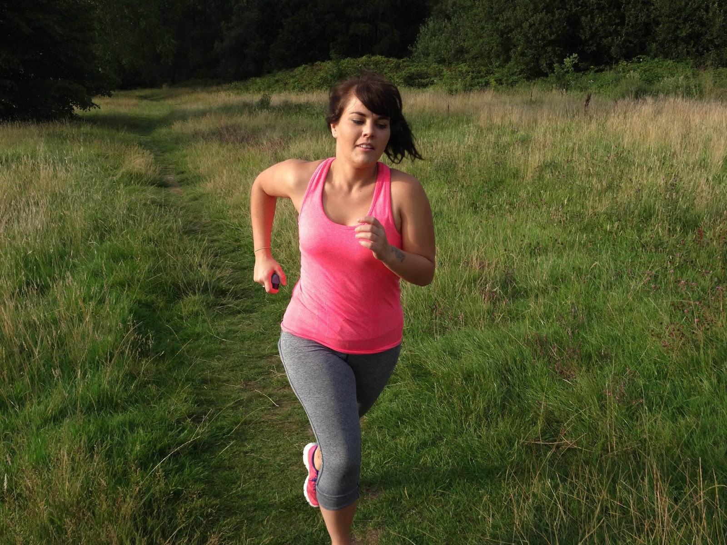
Domain modelling
Participant studies to acquire and evaluate crowdsourced arguments
We can quickly and easily obtain a large number of arguments. We can crowdsource the evaluation of arguments.
Many are similar and can be clustered using automated methods. We can obtain linguistic variants (e.g. informal language).
We can obtain good coverage (e.g. with respect to the Sports England study on reasons why young women do not do sport).
We can crowdsource counterarguments to each argument.
Lisa Chalaguine, Fiona Hamilton, Anthony Hunter, and Henry W. W. Potts (2019) Impact of Argument Type and Concerns in Argumentation with a Chatbot, Proceedings of ICTAI’19, pages 1549-1554, IEEE Press.

Slide 23
User modelling
Domain models
User models
Dialogues

Slide 24
User modelling
Key features of a user model
Probability assignment to arguments: This reflects the belief that a user has in each argument being acceptable.
Preference relation over concerns: This reflects the relative importance a user has in the concerns raised or addressed by the arguments, and is a proxy for the goals of the agent.
Safety > Time > LocalEnvironment > LocalEconomy
Optional features of a user model
Demographic: E.g., age, gender, occupation.
Psychological: E.g., OCEAN personality profile, emotional state.

Slide 25
User modelling
Epistemic approach to probabilistic argumentation
Let P be a probability distribution.
P ∶ PowerSet(Arguments) → [0, 1]
Example
Suppose I hear one of my friends saying argument A and another saying argument B.
A = John suffers from hay fever, and so a pic- nic in the hay field will be unpleasant for him.
B = John has taken a homeopathic medicine for hay fever and therefore he won’t suffer from hay fever.
If I believe that homeopathic medicine is just water, then I have high belief in A
and low belief in B (e.g. P(A) = 0.9 and P(B) = 0).

Slide 26
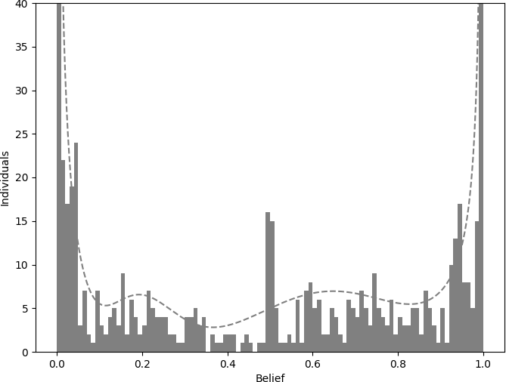
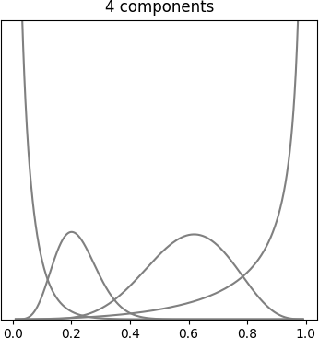
User modelling
Because different agents can have different beliefs in an argument, we need to reflect the uncertainty in the beliefs.
One way is to use a beta distribution which can be interpreted as giving the probability that P(A) has a specific value.
Figure: Data from Lukin et al. Figure: Beta distributions
Lukin, Stephanie M., Pranav Anand, Marilyn Walker, Steve Whittaker (2017) Argument Strength is in the Eye of the Beholder: Audience Effects in Persuasion. Proceedings of EACL’17.
E Hadoux and A Hunter (2018) Learning and Updating User Models for Subpopulations in Persuasive
Argumentation Using Beta Distributions, Proceedings of AAMAS’18, pages 1141–1149.

Slide 27
Dialogues
Domain models
User models
Dialogues

Slide 28
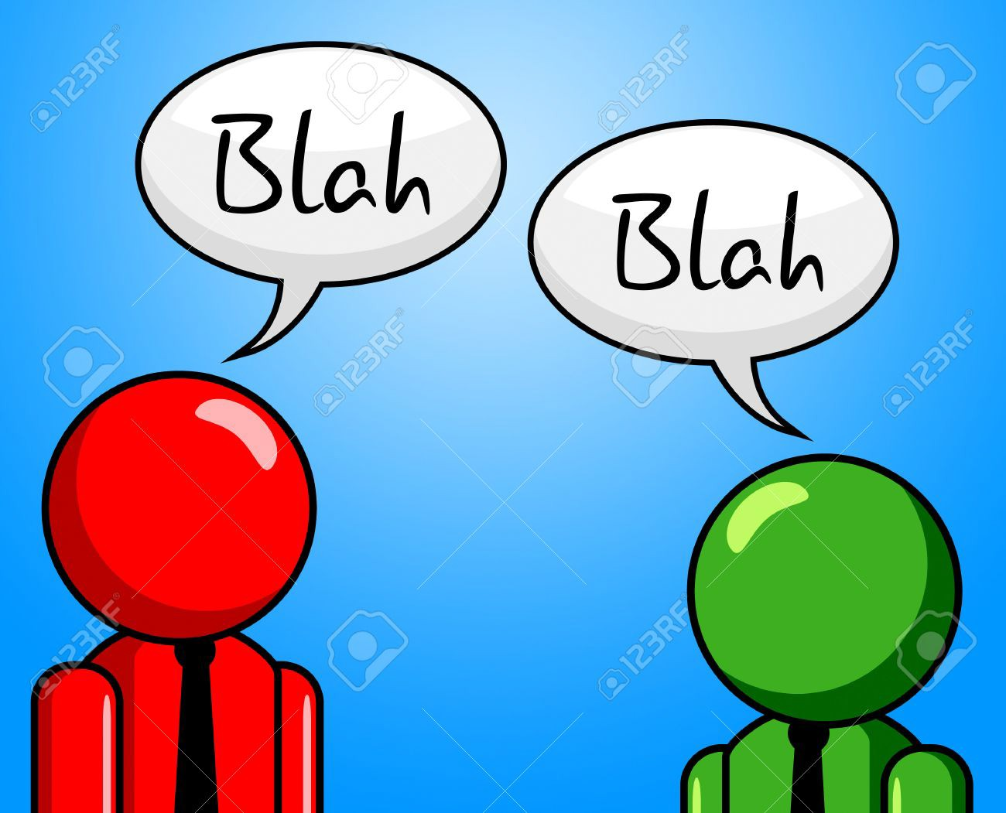
Dialogues
Dialogue
A sequence of moves (e.g. posits, queries, concessions, etc.)
The system (i.e. the persuader) and the user (i.e. persuadee) take turns.
For the persuader, the aim of the dialogue is to persuade the persuadee to believe, or not believe, a specific goal argument (e.g. you are eat too much fast food, and so you should try to five fruit & veg a day).
Protocol
The protocol specifies what moves are allowed by each partcipant in a dialogue at each step of the dialogue.

Slide 29
Strategies for dialogues
Strategies for the persuader (system)
In order to optimize a dialogue (i.e. to maximize the probability that the persuasion is successful), the strategy chooses the best moves for the persuader to make in response to the moves made by the persuadee.
Persuader (system) makes choice of best move from available moves
Random strategy Non-deterministic choice of move from available moves.
Local strategy Pick next move from available moves that is maximal according to some measure of quality.
Global strategy Consider all possible dialogues, and pick dialogue that maximizes a reward function.

Slide 30
Strategies for dialogues
Example (A local strategy for taking concerns into account)
The following is a user argument:
Building cycle lanes is too expensive for the city.
The following are potential counterarguments with concern assignments.
CityEconomy Evidence shows that infrastructures for cyclists favour the local economy generating more taxes for the city to use..
PersonalEconomy Cycling is cheaper for the citizens than driving or
public transportation.
This ranking over concerns implies counterargument 2 is the best move.
PersonalEconomy > Time > Comfort > Health > CityEconomy

Slide 31
Strategies for dialogues
Simulating the change in belief in arguments during a dialogue
Let D = [m , . . . , m ] be a dialogue. Each user model P is obtained from P
1 n i i −1
and mi using an update method.
m1 m2
mi
mn
P0 P1 P2
Pi
Pn
Example
i | 0 1 |  |  | 2 |  | 3
mi ( ) | Posit |  | A | Posit | B | Posit | C
Pi A | 0.5 | 0.9 | 0.3 |  | 0.8
A B C
Anthony Hunter (2015) Modelling the Persuadee in Asymmetric Argumentation Dialogues for Persuasion, Proceedings of IJCAI’15, pages 3055-3061, AAAI Press
31 / 55

Slide 32
Strategies for dialogues
For a global strategy, simulate the construction of all possible dialogues:
Each arc denotes a move.
Score each simulated dialogue based on beliefs and concerns according to user model.
Treat risk of disengagement of persuadee by discounting.
Choose optimal policy (i.e. the best move the persuader has to make whatever move made by persuadee).
E Hadoux and A Hunter (2017) Strategic Sequences of Arguments for Persuasion Using Decision Trees, Proceedings of AAAI’17, pages 1128-1134.

Slide 33
Strategies for dialogues
Example (Using the bimaximax decision rule - games in extensive form)
n1 (3/6)
For (x/y), x (resp. y)
is persuader (resp. persuadee) utility
[a₁ ] You can join the office daily walk to get fit.
[a₂ ] You can join the office daily run to get fit.
n2 (3/6)
n3 (0/0)
[a₅ ] I would rather miss the pleasure of so- cializing than suffer a run.
[a₇ ] I would find it very embarrassing to be sweaty in front of my colleagues, but I will think about it.
[a₃ ] I will join because walk- ing with my colleagues will be fun.
[a₄ ] I will go walking with my colleagues but only once a week.
[a ] I will join
6
because run- ning is a great way to get fit.
n4 (6/4)
n5 (3/6)
n6 (-8/-1)
n7 (9/-8)
n8 (0/0)
Emmanuel Hadoux, Anthony Hunter and Sylwia Polberg (2018) Biparty Decision Theory for Dialogical Argumentation, Proceedings of COMMA18, pages 233–240, IOS Press.

Slide 34
Evaluation
Cycle commuting study
We used an argument graph with 51 arguments on the topic of commuting by bicycle in the city and 8 concerns (Health, Fitness, Comfort, Time, Personal Economy, City Economy, Environment, and Safety).
We undertook pre-studies to validate key assumptions
Participants tend to agree on assignment of concerns to arguments. Participants give meaningful preferences over types of concern.
Participants play by their preferences over concerns.
We ran a chatbot on the web with 100 crowdsourced participants to persuade them to commute by cycle.
 | Strategic system | Baseline system
Negative to positive | 6% | 6%
Positive to negative | 0% | 4%
We obtained a statistically significant improvement in persuasion when compared with a baseline system.
Emmanuel Hadoux and Anthony Hunter (2019) Comfort or Safety? Gathering and Using the Concerns of a Participant for Better Persuasion, Argument and Computation, 10(2):113-147.

Slide 35
Evaluation
Student fees study
We have over 150 arguments on the topic of the UK 9K student fee and 10 concerns (Economy, Government finance, Employment, Student finance, Education, Student satisfaction, Student well-being, University management, Commercialization of universities, Fairness, and Society).
We crowdsourced assignment of concerns and beliefs to arguments, and preferences over concerns, for the user model from over 400 participants.
We have compared our chatbot with a baseline system using 260 crowdsourced participants where for each participant,
if they believe the 9K fee should remain (respectively be abolished), we try to persuade them that it should be abolished (respectively should remain).
We obtained a statistically significant increase in belief in a persuasion goal when compared with a baseline system.
The difference in performance is attributable to the better choice of moves made by our chatbot.
Emmanuel Hadoux, Anthony Hunter and Sylwia Polberg (2021) Strategic Argumentation Dialogues for Persuasion: Framework and Experiments based on Modelling the Beliefs and Concerns of the Persuadee, arXiv:2101.11870v1.

Slide 36
Evaluation
Debt advice study — a 9 month follow-on project
We are working with the Money and Pensions Advice Service — a UK government agency aimed at helping people make good financial decisions.
We plan to deploy a chatbot on their website to persuade people to use their financial planning tools.
We will evaluate success in terms of the number of people who say they will use the tools, and how many of those then click through to use those tools.

Slide 37
Further developments
Domain models
User models
Dialogues

Slide 38
Epistemic graphs: An introduction
Towards richer user models
Capturing relationships The graphs can model both attack and support as well as relations that are neither positive nor negative.
Modelling belief in arguments In the epistemic graphs approach, the argument graph is augmented with a set of epistemic constraints that can restrict the belief and state how beliefs in arguments influence each other.
Modelling imperfect agents It also allows for better modelling of imperfect agents, which can be important in multi–agent applications.
Anthony Hunter, Sylwia Polberg and Matthias Thimm (2020) Epistemic Graphs for Representing and Reasoning with Positive and Negative Influences of Arguments, Artificial Intelligence, 281: 103236.

Slide 39
Epistemic graphs: Example
A = The train will arrive at 2pm because it is timetabled for a 2pm arrival.
– −
+
C = The train appears to be
D = The live travel info app lists it as arriving on time.
B = Normally this train service arrives a bit late.
travelling slower than normal.
Figure: Example of an epistemic graph. The + (resp. −
) label denote support
(resp. attack) relations. These are specified via the following constraints.
ϕ1 ∶ p(D) > 0.8 ∧ p(B ∨ C) < 0.2 ⇒ p(A) > 0.8 ϕ2 ∶ p(D) > 0.5 ∧ p(B ∨ C) ≤ 0.5 ⇒ p(A) > 0.5 ϕ3 ∶ p(B ∧ C) > 0.5 ⇒ p(A) < 0.5

Slide 40
Epistemic graphs: Advantages
Epistemic graphs allow us to both model the rationale behind the existing dialectical semantics as well as completely deviate from them when required.
There is some resemblance with variants of abstract argumentation such as ranking and weighted approaches, but the conceptual differences between epistemic probabilities and abstract weights lead to significant differences in modelling.
Epistemic graphs are expressive and flexible for argumentation that supports
Subjective reasoning by allowing different agents to be modelled by a different set of constraints.
Context-sensitive reasoning by basing constraints on what arguments represent rather than the just the structure of graph.
Epistemic graphs also allow for better modelling of imperfect agents, which can be important in dialogical argumentation (e.g. persuasion, negotiation, etc.).

Slide 41
Epistemic graphs: Example
F = I like to maintain a good physi-
cal appearance.
B = Having a regular check-up will help me keep my teeth looking good.
I = If I let a dental problem develop, it will be much
more painful.
+
−
+
+
−
E = I find having dental check- ups painful.
−
−
C = Having a regular check-up will help me keep my teeth healthy.
A = I should book regular dental check-ups.
G = I like to be healthy.
+
D = I am too busy during the day when the clinic is open.
−
K = Dental care is free if you have a low income.
J = I don’t have the money to pay for a dentist.
H = If I let a dental problem develop, it will take much more time to resolve it.
−
Figure: Epistemic graph for the domain model for a case study on encouraging people to take regular dental check-ups. These graphs offer richer strategies for selecting moves.

Slide 42
Epistemic graphs: Example
−
−
A = The Red team can be formed if at least one engineer and exactly one designer are present and the Blue team has not been formed.
B = The Blue team can be formed if at least two engineers and at least one designer are present and the Red team has not been formed.
+
+
+
+
∗
+
∗
+
C = Mark is an engineer
D = Emma is
E = David
F = Samantha
an engineer and is present.
is a designer and is present.
is a designer and is present.
and is present.
Figure: Edges labelled with −
, + and ∗ represent attack, support and
dependency respectively. Forming of the Red and Blue teams requires particular specialists. If we accept E, then acceptance of F leads to the rejection of the Red team, and if we accept F, then the acceptance of E leads to the rejection of the Red team. At the same time, one of E and F has to be accepted. Thus, the relations from E and F are in some cases attacking, in some supporting, and hence they can only be classified as dependent.

Slide 43
Epistemic graphs: Updating
Aim of updating
Given a probability distribution, a epistemic graph, and update in the form of a set of new constraints, how do we update the probability distribution?
Some examples of behavioural phenomena to be modelled
Friction when updating Instating an attack on argument does not cause the belief to drop to 0, and reinstating an argument (i.e. by a defence), does not cause the belief to rise to 1.
− −
C B A
Diminution of influence Suppose A has an increase in belief. The further an argument is away from A, the lower change in belief.
− − − −
E D C B A
Nico Potyka, Anthony Hunter and Sylwia Polberg (2018) Updating Belief in Arguments in Epistemic Graphs, Proceedings of KR’18, (PDF), pages 138–147, AAAI Press.
A Hunter, N Potyka, and S Polberg (2019) Delegated Updates in Epistemic Graphs for Opponent Modelling. International Journal of Approximate Reasoning, 113: 207–244.

Slide 44
Towards more natural interactions
Domain models
User models
 | Dialogues
Natural Language Interface

Slide 45
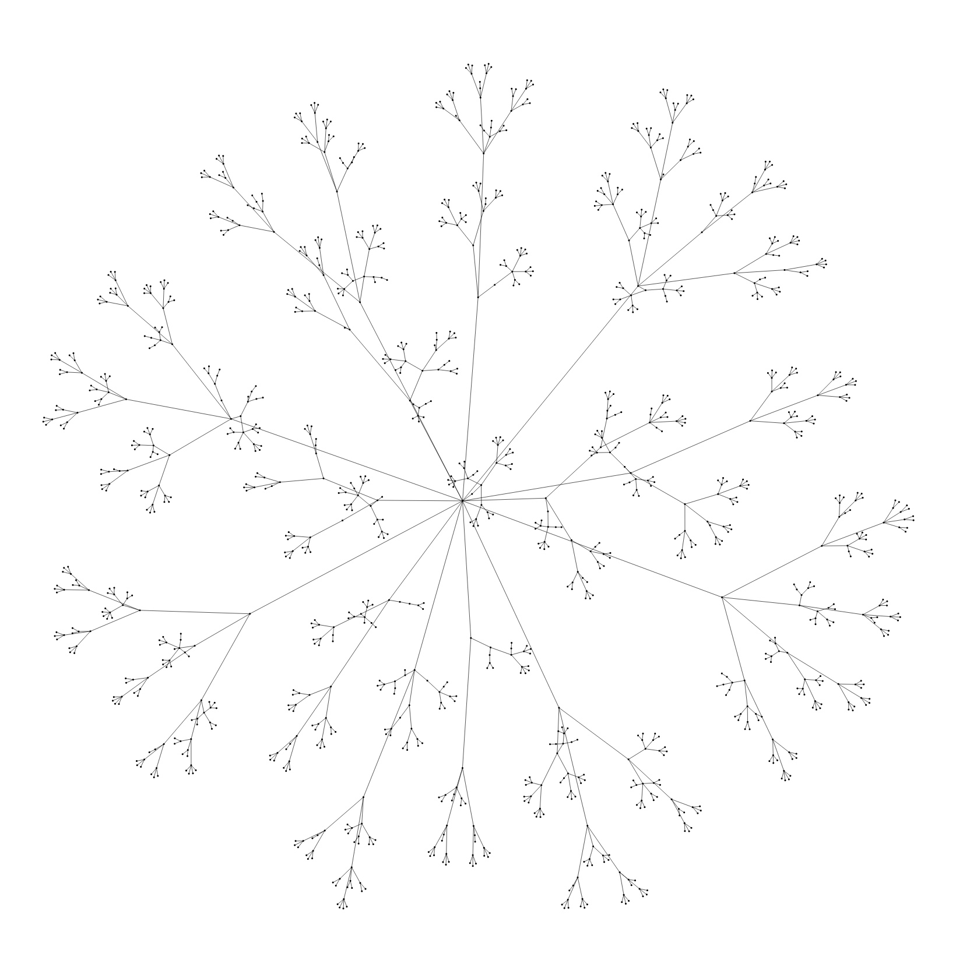
Persuasive chatbot with natural language interface
University Fees Corpus with 1288 arguments
Lisa Chalaguine and Anthony Hunter (2019) Knowledge Acquisition and Corpus for Argumentation-Based Chatbots, Proceedings of Workshop on Advances In Argumentation In Artificial Intelligence. CEUR Workshop Proceedings, volume 2528, pages 1–14.

Slide 46
Persuasive chatbot with natural language interface
User argument.
Find arguments in graph that are similar to user argument.
(Cosine similarity on word vector using Glove)
Some similar arguments
No similar arguments
For each similar argument, get its counterarguments from the graph.
Find concerns in user argument.
(Logistic regression clas- sifier on keywords)
Pick default argument.
Pick counterargument that best matches the concerns in the user argument.
System argument.
Lisa Chalaguine and Anthony Hunter (2020) A Persuasive Chatbot Using a Crowd-Sourced Argument Graph and Concerns, Proceedings of COMMA’20, pages 9–20, IOS Press

Slide 47
Persuasive chatbot with natural language interface
Experimental methods
Chatbots were deployed on Facebook.
50 participants were recruited for each of the two chatbots (baseline and strategic)
Before the chat the users were directed to a Google Form and asked whether they strongly disagreed, disagreed, neutral, agreed or strongly agreed that university fees should be kept
At the end of the chat the chatbot presented the user with a link that redirected them to a second Google Form where they were asked a series of questions
Did you feel understood by the chatbot? (Yes/No/Sometimes)
Did you feel that the chatbots arguments were relevant? (Yes/No/Sometimes)
Do you feel like all your points were addressed? (Yes/No/Some of them)
How much do you agree that fees in the UK should be kept as they are? (Strongly disagree - strongly agree)
Lisa Chalaguine and Anthony Hunter (2020) A Persuasive Chatbot Using a Crowd-Sourced Argument Graph and Concerns, Proceedings of COMMA’20, pages 9–20, IOS Press

Slide 48
Persuasive chatbot with natural language interface
Results on length and composition of dialogues
On average chats lasted 24 turns, meaning that the chatbot gave 12 arguments (7 default arguments and 5 from the graph).
Results on dialogue quality
Chatbot | Un | dersto | od (Q1) | Releva | nt Arg | s (Q2) | Points | addres | ses (Q3)
 | Yes | No | Sometimes | Yes | No | Some | Yes | No | Some
Baseline | 16 | 4 | 30 | 21 | 3 | 26 | 13 | 15 | 22
Strategic | 15 | 6 | 29 | 31 | 1 | 18 | 10 | 14 | 26
Results on change in stance
Chatbot |  | Baseline |  |  | Strategic
Change in stance | Neg. | No Change | Pos. | Neg. | No Change | Pos.
No. of participants | 5 | 41 | 4 | 1 | 26 | 23
Change in CS points | -5 | 0 | 5 | -1 | 0 | 32
Lisa Chalaguine and Anthony Hunter (2020) A Persuasive Chatbot Using a Crowd-Sourced Argument Graph and Concerns, Proceedings of COMMA’20, pages 9–20, IOS Press

Slide 49
Overview of computational persuasion project
Argument Acquisition
Population modelling
Domain models
User models
Dialogues
Interface
We explored a range of options in the project
Domain modelling: Abstract argumentation / Probabilistic argumentation
Argument acquisition: Authoring / Crowdsourcing
User modelling: Beliefs / Concerns
Population modelling: Beta distributions / Machine learning
Dialogue strategy: Local / Global
Interface: Menu / Free-text

Slide 50
Explainable AI
Relationships with explanation?
Computational persuasion

Slide 51
Relationships with explanation?
Example
Explanation but not persuasion
The Pfizer vaccine is stored at a very low temperature because it is biologically unstable.
Persuasion but not explanation
Take the covid vaccine. Everyone else is.
Explanation and persuasion
Take the covid vaccine. It will substantially lower your risk of getting seriously ill (or worse).

Slide 52
Relationships with explanation?
 | Persuadee utility Positive Negative
Positive Negative | Equitable Exploitative (e.g. sales-agent/customer) (e.g. fraudster/victim) Altruistic ???? (e.g. Samaritan/caller )
Persuader utility
Types of persuasion dialogue
Examples are of persuader/persuadee.

Slide 53
Relationships with explanation?
Does computational persuasion involve manipulation?
Some non-manipulative approaches
Provision of information to persuadee via arguments Overturning misconceptions in persuadee via counterarguments
Some mildly manipulative approaches Use of emotional arguments
Invocation of emotion through choice of language Framing of arguments
Use of techniques such as appeal to authority
Some substantially manipulative approaches
Use of dishonesty (e.g. false or unsound arguments) Exploiting biases of persuadee
Exploiting ignorance & errors in persuadee Manipulating trust of persuadee in persuader Bullying of persuadee (e.g. gaslighting)

Slide 54
Relationships with explanation?
Explanation for persuasion
Non-manipulative persuasion is founded on good explanations
Persuasion for explanation
Maintain a model of the user
Choose the explanations that are most likely to resonate with the user Don’t bombard with exhaustive coverage of all arguments
Be selective in the content that is presented
Choose the most effective language to communicate with the user
Explainable AI should harness computational persuasion

Slide 55
Conclusions
Conclusions
Computational persuasion based on computational models of argument is a promising approach to technology for behavioural change applications.
Next steps
Further develop
domain modelling user modelling dialogue strategies
natural language interfaces
Further evaluation with participants.
More information
www.computationalpersuasion.com

